Slide 1


OPTIMIZING SUSTAINABLE COMMUNITY-BASED TOURISM: SOUTH AFRICAN SCENARIOS AND SOLUTIONS
Professor K.L. Harris & C.R. Botha
Department of Historical and Heritage Studies
University of Pretoria
Department of Tourism Research Seminar
Future Africa, Pretoria
24 October 2025

Slide 2

OPTIMIZING SUSTAINABLE
COMMUNITY-BASED TOURISM:
SOUTH AFRICAN SCENARIOS & SOLUTIONS

Slide 3
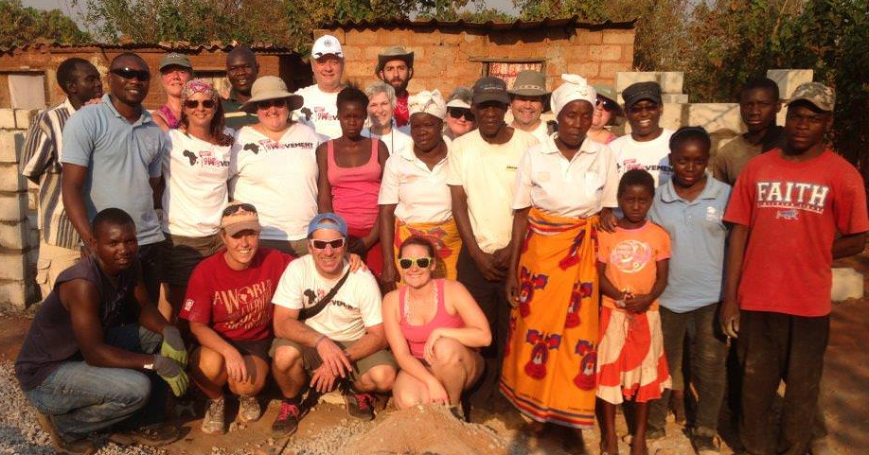
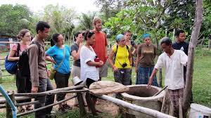
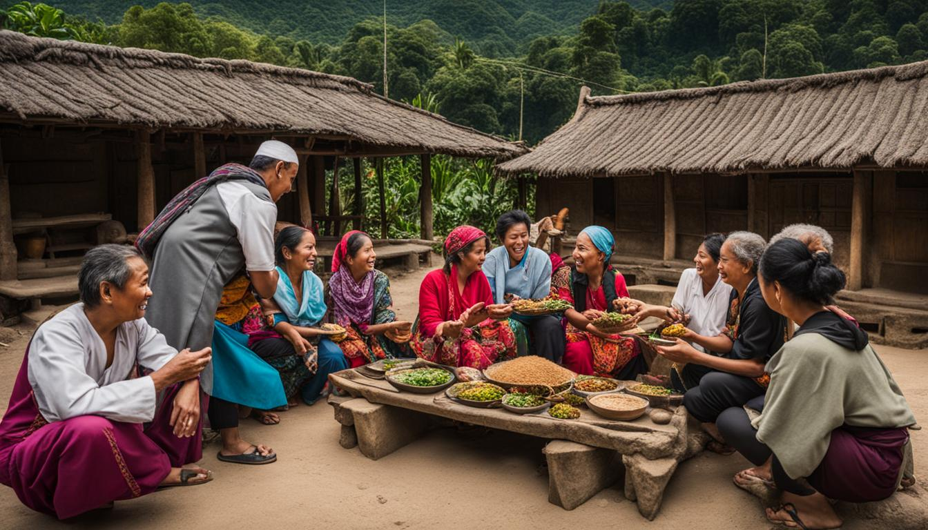
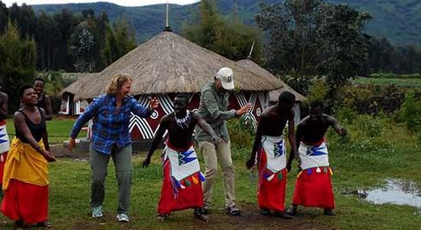
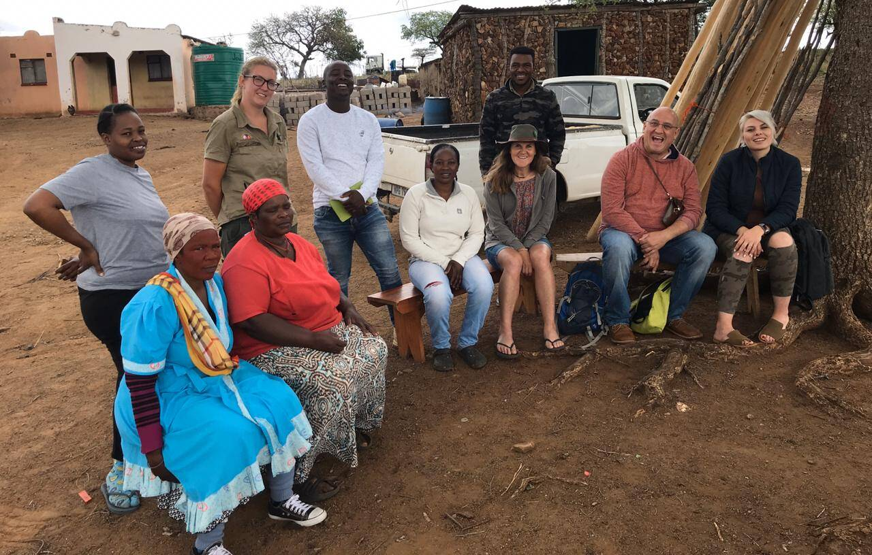
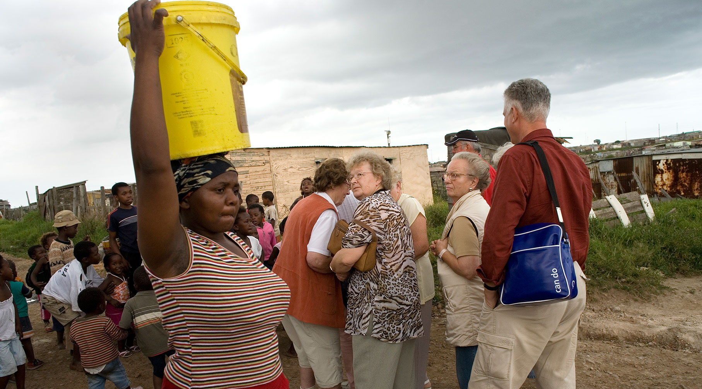
COMMUNITY-BASED TOURISM

Slide 4

Participatory
role
players
Economic
benefits
Uplifting
communities
Marginalised
communities
Preserving
and sustaining
cultural heritages
COMMUNITY-BASED
TOURISM
Empowering
communities
Benefits
remain
within
communities
Communities
active
participants

Slide 5
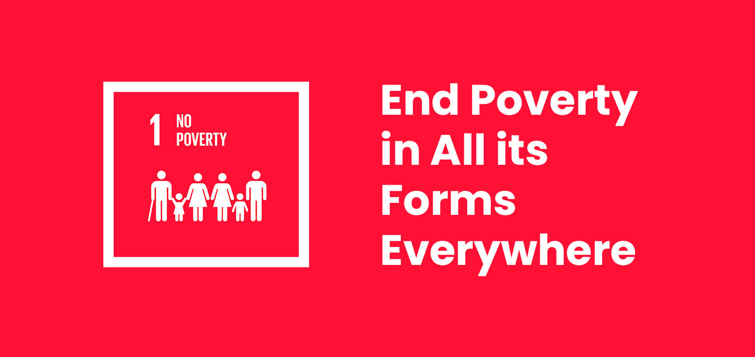


SDG 1
SDG 8

Slide 6
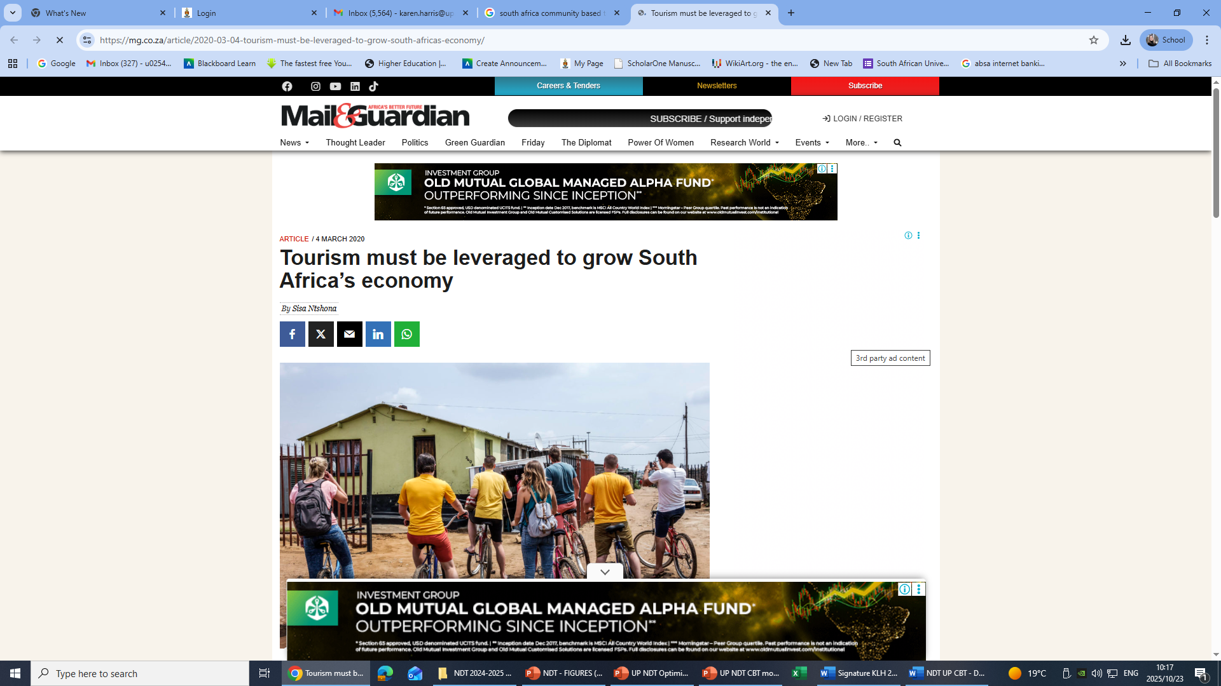

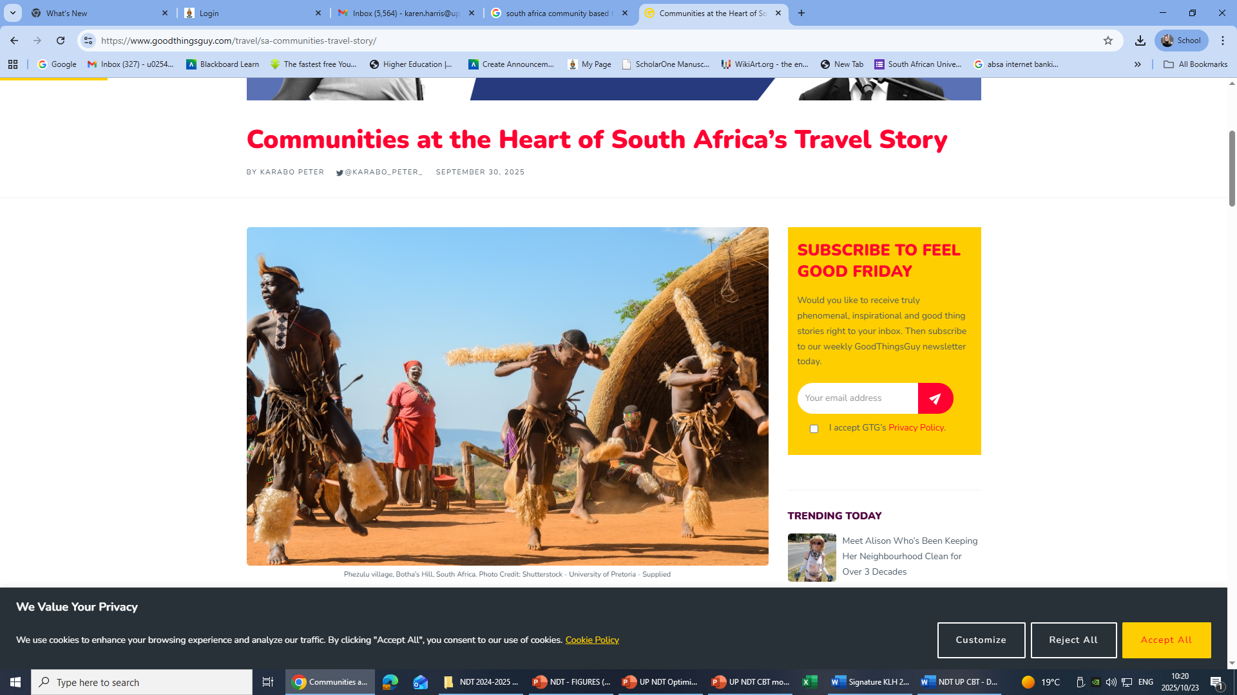
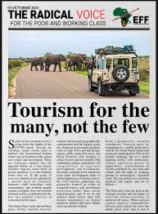

COMMUNITY-BASED TOURISM

Slide 7
Contrived?
Exploitative?
Abusive?
Disruptive?
ACADEMIC SCRUTINY OF
COMMUNITY-BASED TOURISM
Intrusive?
Unauthentic?
Commodified?
Artificial?
Fake?

Slide 8
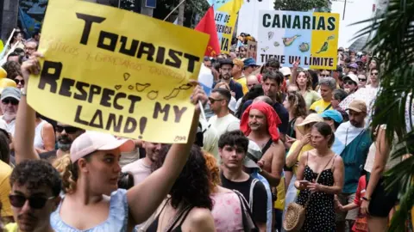
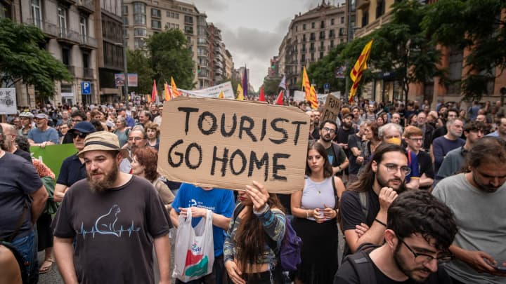
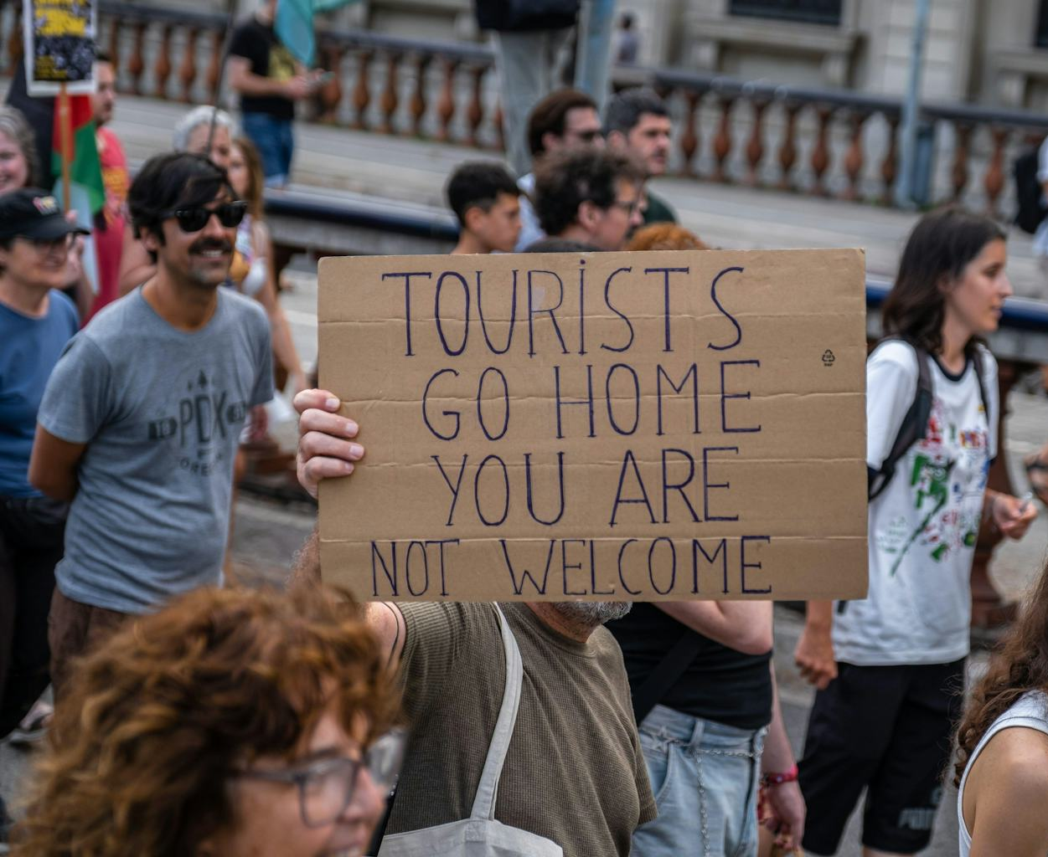
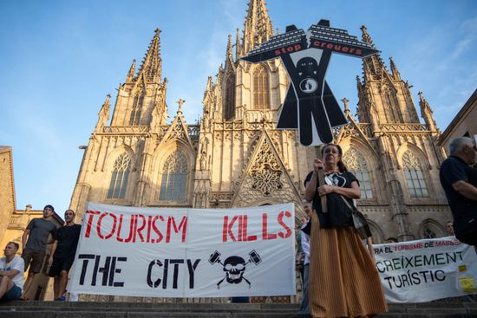
INCREASING RESISTANCE TO TOURISM

Slide 9

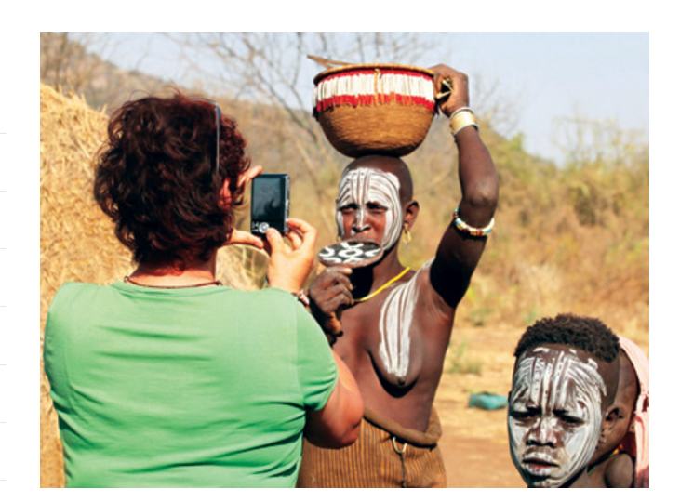
FRAMING
THE
OTHER
FRAMING THE OTHER is about a tourist whose comfortable ideas about taking photos of exotic tribal people in Ethiopia are shaken by her encounter with a Mursi woman.

Slide 10



COMMUNITY-BASED TOURISM

Slide 11
MANDATE:
Actionable recommendations based on the findings that can inform policy, planning, and interventions within the community-based tourism sector
Revisit the concepts
Revaluate stakeholders
Deconstruct processes
Realign policies
Notes:
Operational guidelines (2016) and community participation framework (2023)

Slide 12
Methodology applied in the study
Mixed method
Qualitative study
Literature review
Stakeholder interviews/discussions
Comparitive analysis
Deduction and development

Slide 13
Processes applied in the study
Analysis and synthesis
Case studies and models
Assessment of the components and attributes
Consideration of successes (strengths) and obstacles (weaknesses)
Reassessment, reconfiguration and recalibration in order to optimize the sustainability of CBT in South Africa

Slide 14
RESEARCH FOCUS
As CBT has not always been practiced or engaged with in an optimal manner – hence the rationale to suggest solutions to “OPTIMIZE” the CBT domain.
The research problem is to address the apparent underperformance of CBT and seek ways in which to REINVIGORATE IT IN A SUSTAINABLE MANNER.

Slide 15
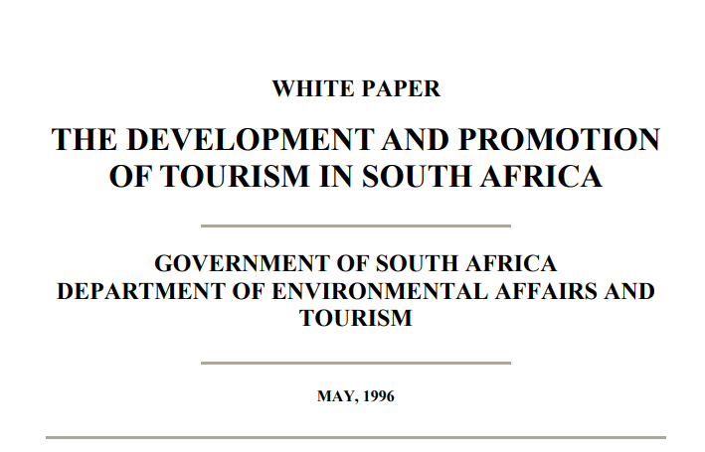
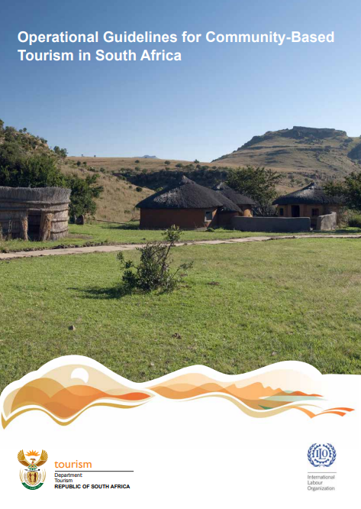
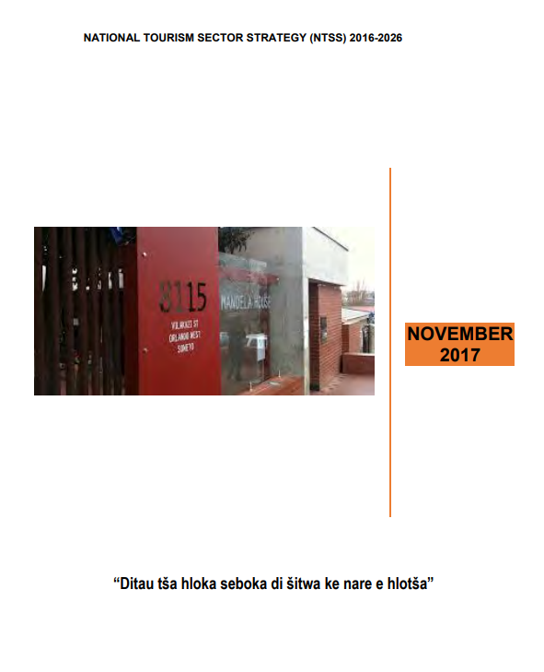
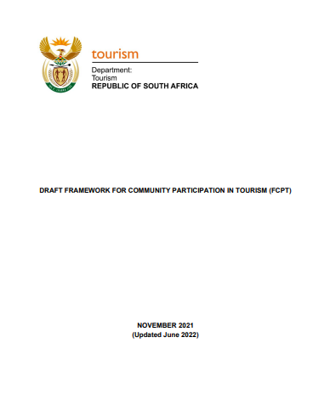
DEPARTMENT OF TOURISM: KEY CBT POLICIES
1996 – White Paper for Development and Promotion of Tourism
2016 – National Tourism Sector Strategy
2016 – Operational Guidelines for CBT
2023 – Framework for community participation

Slide 16
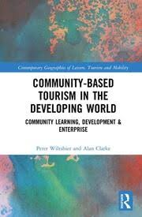
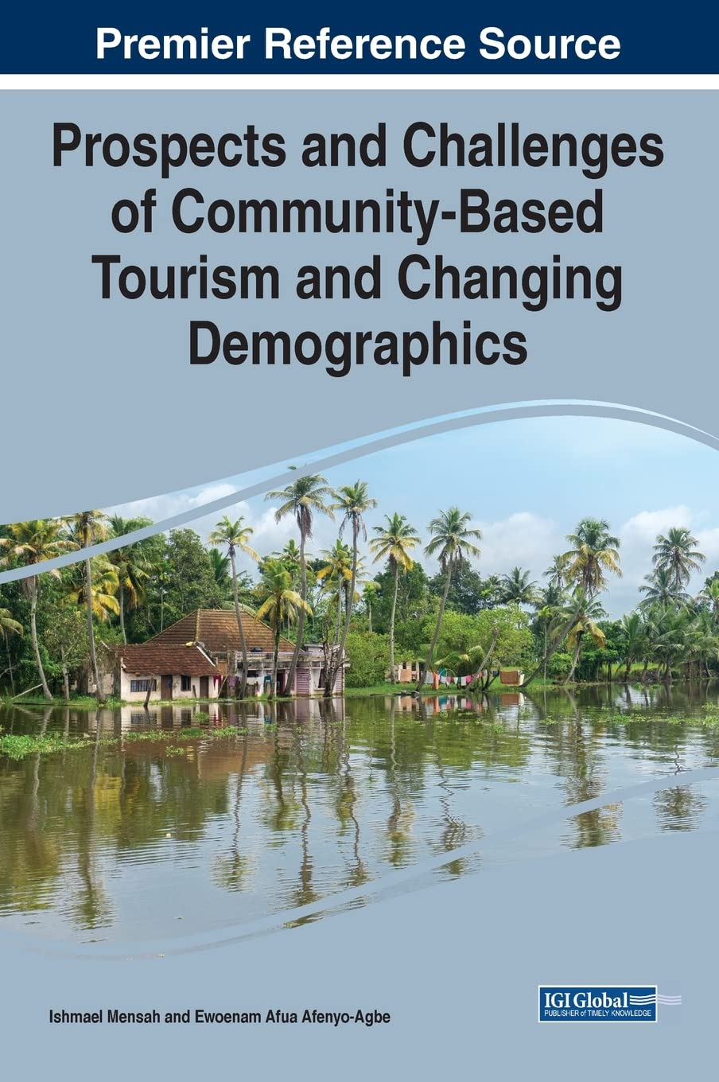
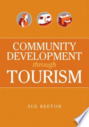
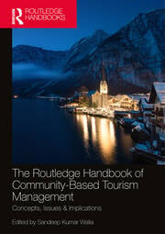
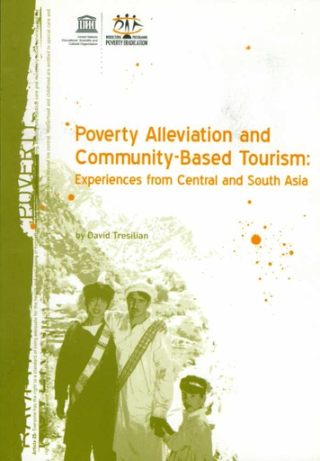
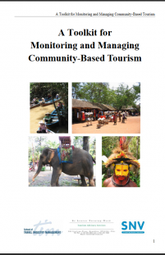
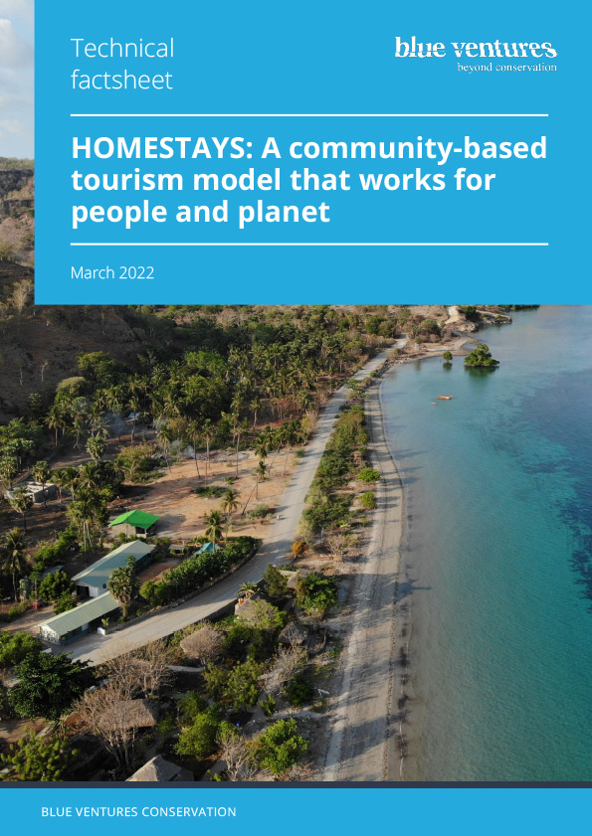
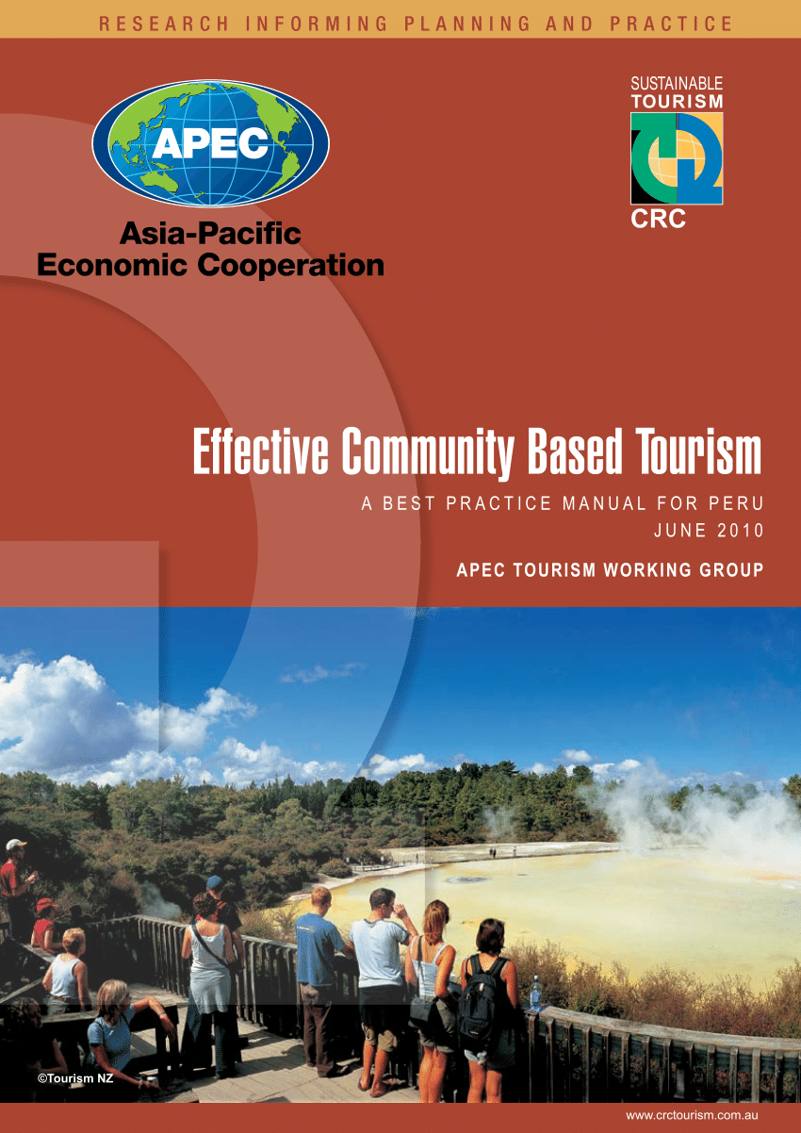
LITERATURE REVIEW – BOOKS

Slide 17
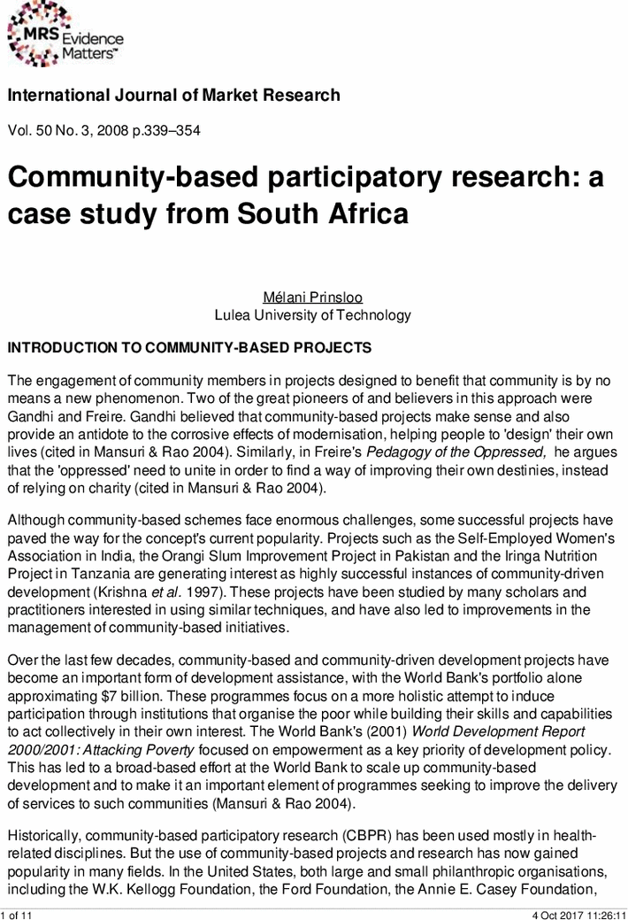
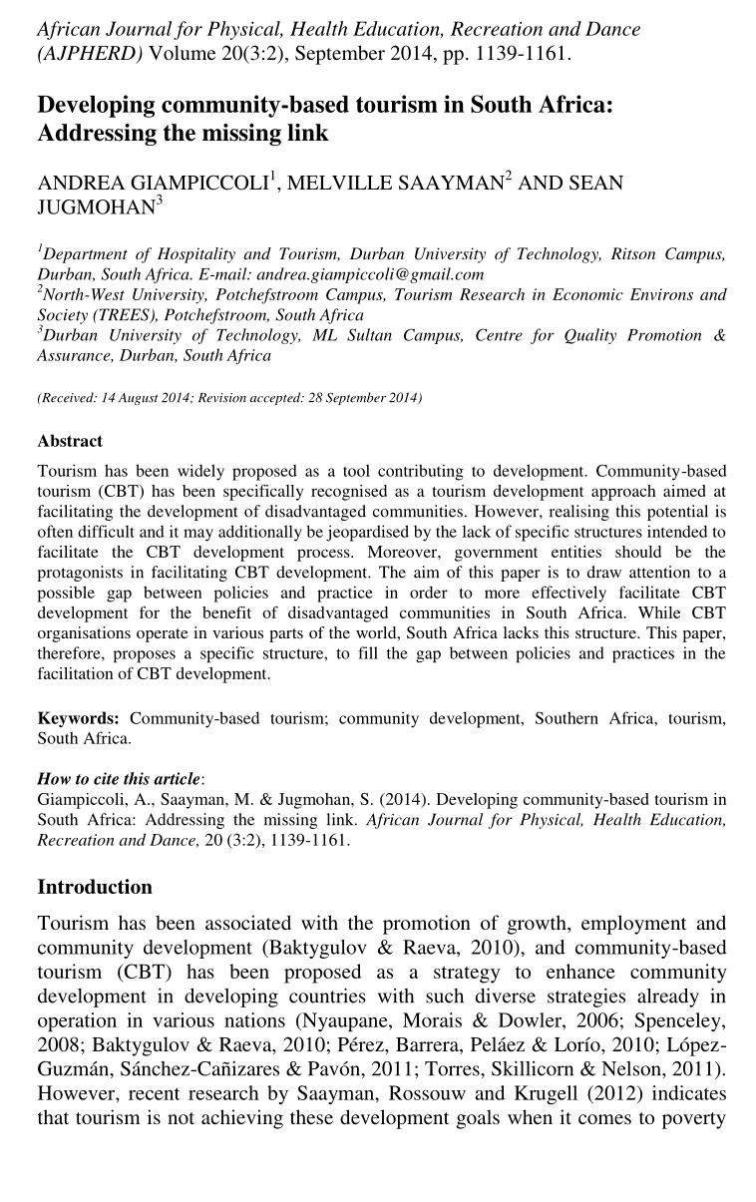
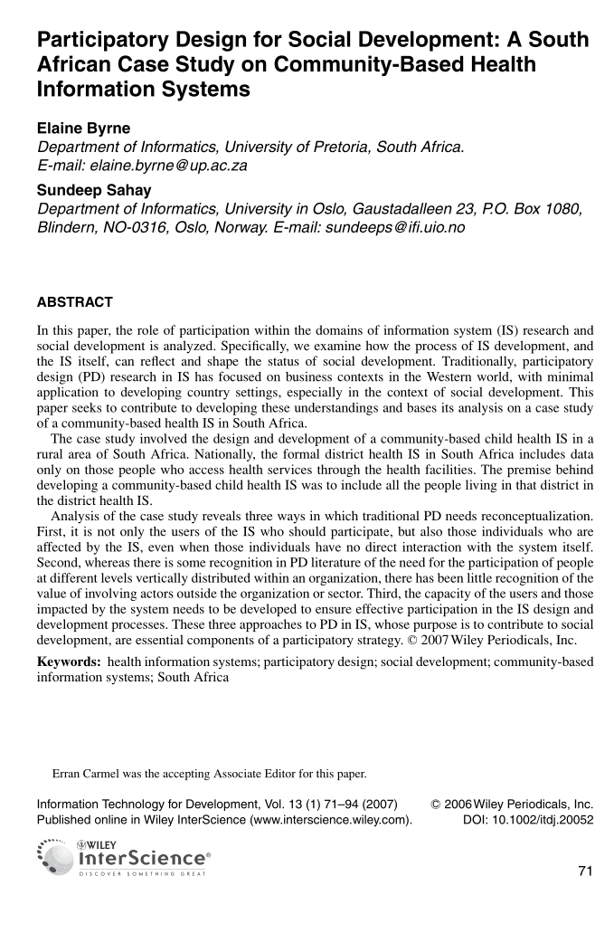
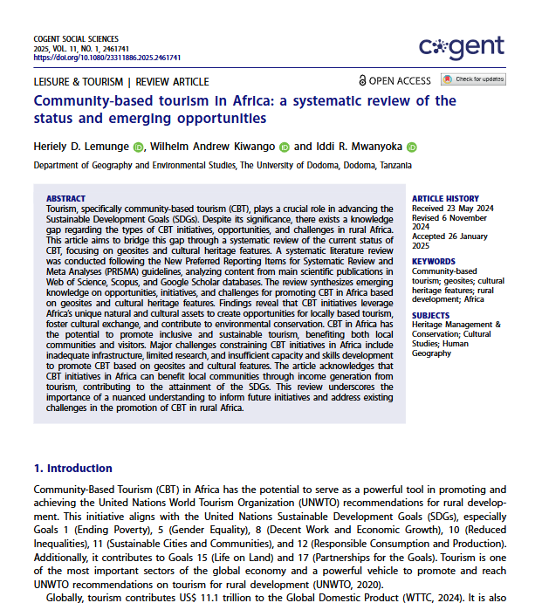
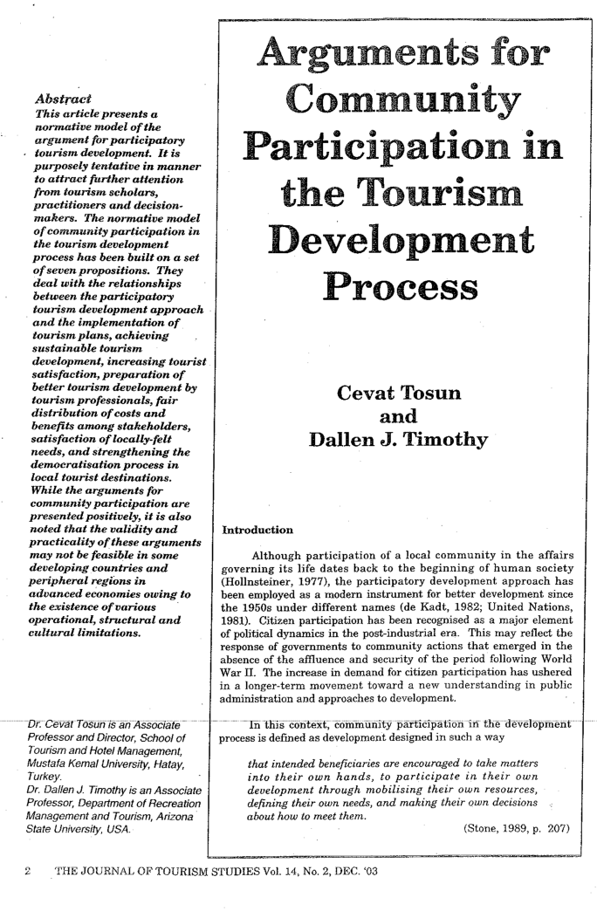
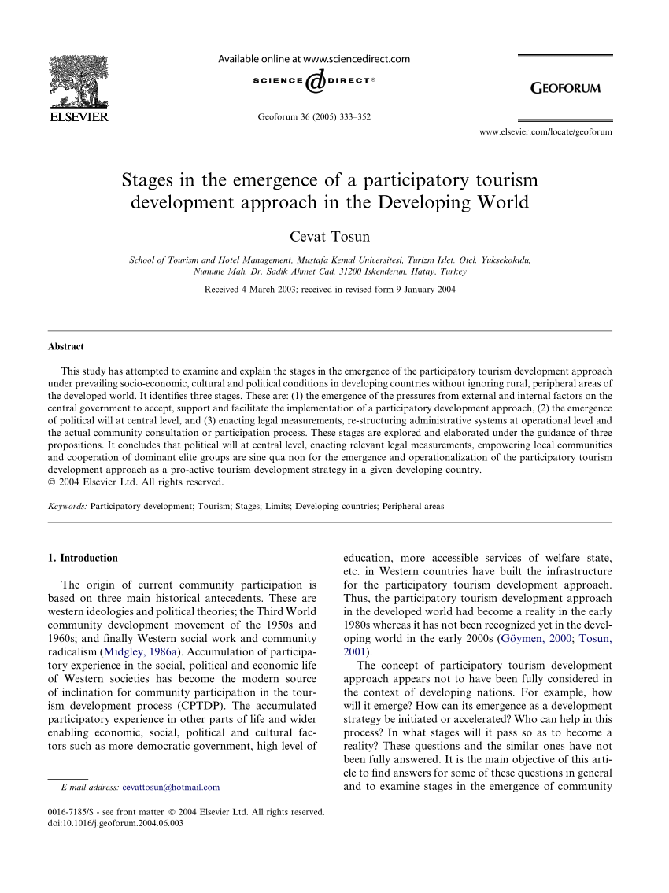
LITERATURE REVIEW - ARTICLES

Slide 18
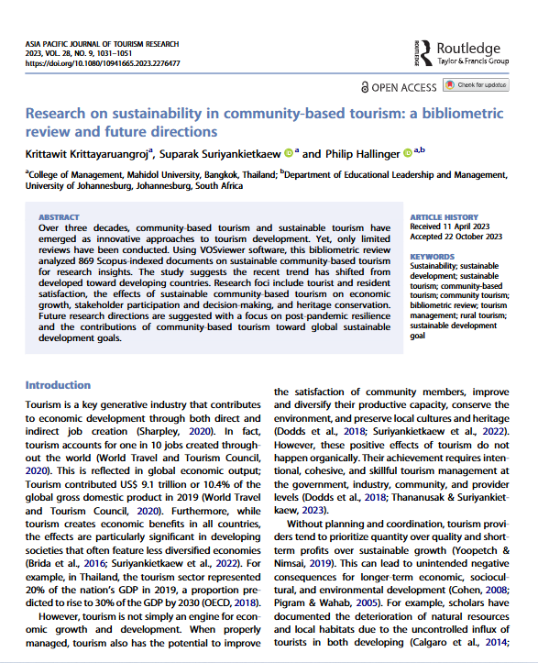
LITERATURE REVIEW
V. Kumar, T. Agarwala & S. Kumar
“Research on sustainability
in community-based tourism: A bibliometric review and future
directions’
… over 350 Scopus indexed publications for the period of six years (1995 to 2021)

Slide 19
LITERATURE REVIEW – SURVEY OF THEMES
History, principles and development discourse
Stakeholders, participation and collaboration
Challenges and obstacles
Benefits and successes
Sustainable and responsible tourism
Positive, negative & ambivalent appraisal
Operating models
South African context

Slide 20
TIME LINE: Community-Based Tourism
Local
tourism
landscapes
Global
South
Origin
Acknowledged
1970s
1980s
1990s
2000+
Alternative
to mass
Tourism;
Economic
lifeline
Manila
Declaration
by the
UNWTO
Key
market
segment
Experienced
based
tourism
Notes:
Since the late 1970s CBT was regarded as an “alternative” to the massification of tourism and was seen as a potential economic lifeline and social change-maker for previously marginalized and disadvantaged communities in the global South. In the 1980s, community involvement in tourism was officially acknowledged in the Manilla Declaration by the United Nations Tourism Organization (UNTWO). This indicated that tourism should not be disadvantageous to the social and economic interests of local communities, but should rather contribute to improving their situations. However, it would only be in the late 1990s, characterized by the shift internationally from a commercialized mass industry to more individualized experience-based economy, that CBT would gain widespread popularity globally and shift to local tourism landscapes

Slide 21
DEFINING COMMUNITY-BASED TOURISM
“Community” = rural, poor and economically marginalized
“Tourism” = people traveling to and staying in places outside their usual environment for leisure, business, or other purposes.
“Community-based tourism” = tourism in which local residents invite tourists to visit their communities with the provision of overnight accommodation.

Slide 22
DEFINING COMMUNITY-BASED TOURISM: TWO CONVENTIONAL PREMISES
A form of tourism where tourists are hosted by a local community, wherein the community offers the visiting tourists a deeper experiential, participatory, unique, authentic and cross-cultural interactive insight into local people, their culture and their environment.
The community in this context serves as the key stakeholder that
exercises ownership, control and/or management over the
tourism development and touristic experience.

Slide 23
REDEFINING COMMUNITY
Community boundaries can be highly political resulting in certain groups feeling threatened when they are seemingly peripheral to official designations.
The fuzzy boundaries of what constitutes a community make governance and the assessment of CBT considerably challenging.
A suggestion is to resist predefining a community and to instead consider its fluid boundaries and heterogeneity in CBT planning and research.

Slide 24
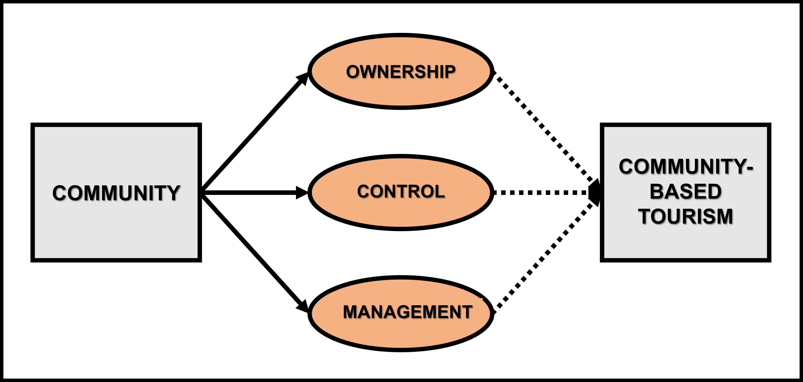
PERCEIVED CONVENTIONAL CBT

Slide 25
KEY CBT MODELS
Communally-owned ventures
Community initiatives in joint ventures with the private sector
Community-based tourism entrepreneurship
Community enterprise linkages with private sector owned tourism businesses

Slide 26
INTERNATIONAL BEST PRACTICE MODELS
“Structural community support model for tourism”
“Community tourism planning model for marginalized destinations”
“Community-based action model to influence tourism”
“Factor analysis model for CBT”
“Governance model for CBT”
“Community-based stakeholder model”
“Structural model for CBT performance”
“Sustainable model for CBT”
“Structural model for sustainable community development”
“Model for the analysis of CBT”

Slide 27
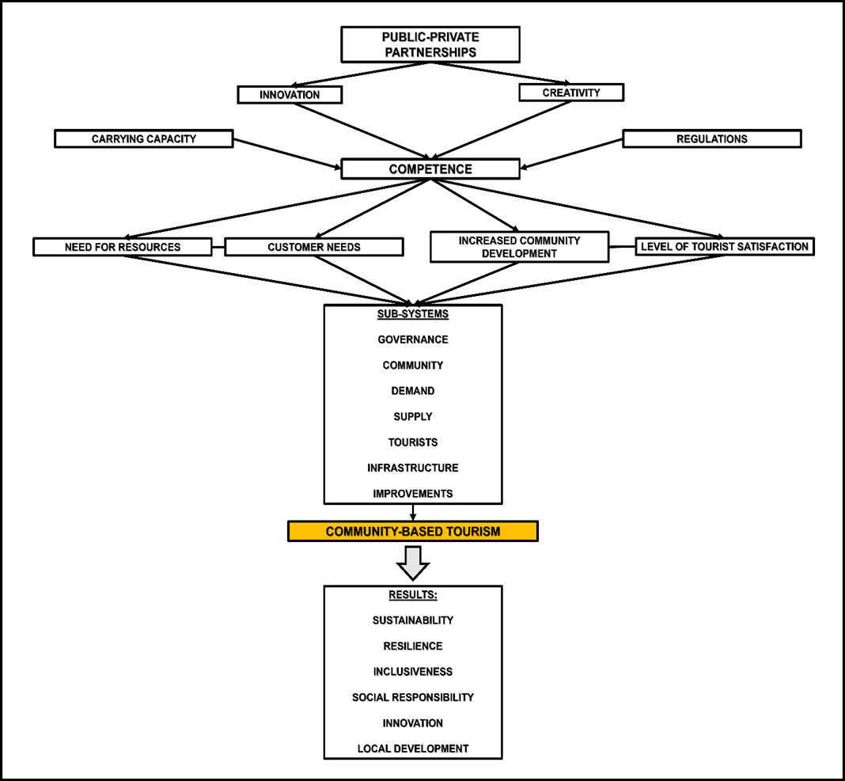
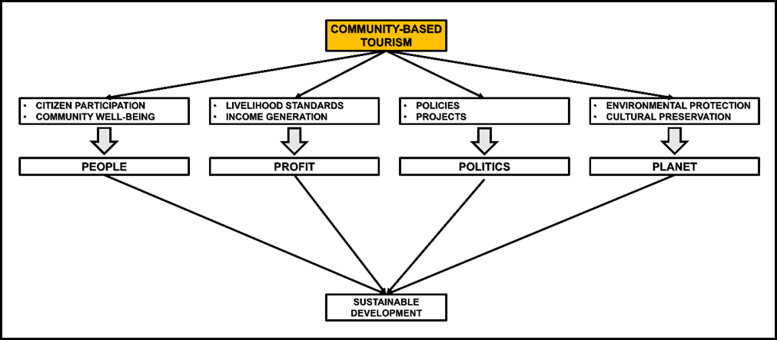
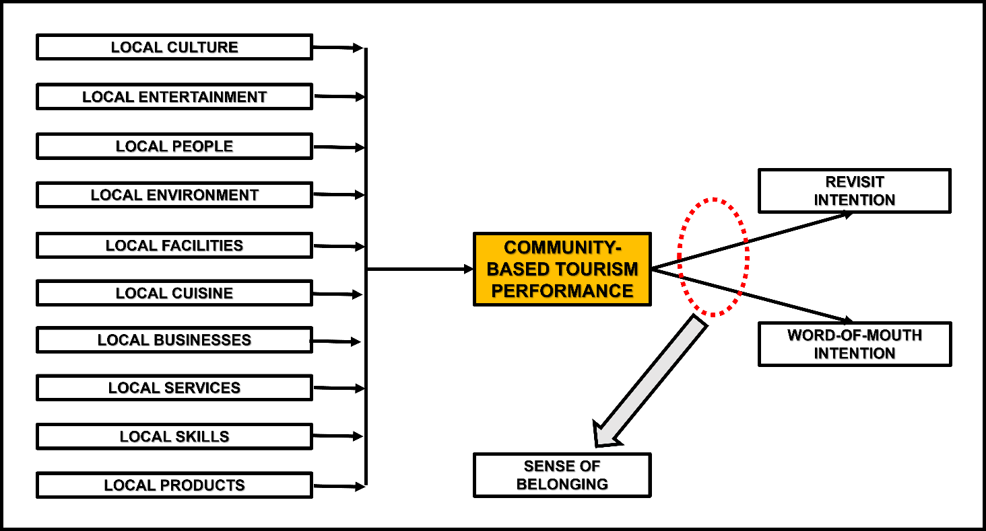
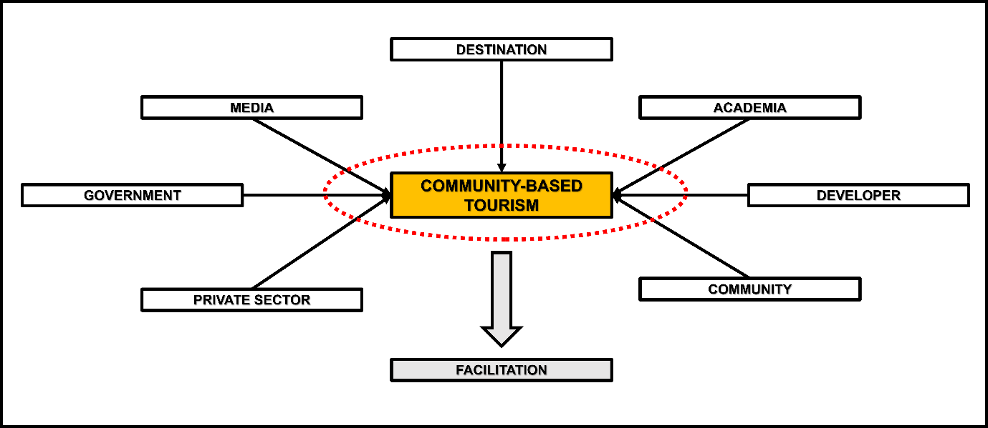
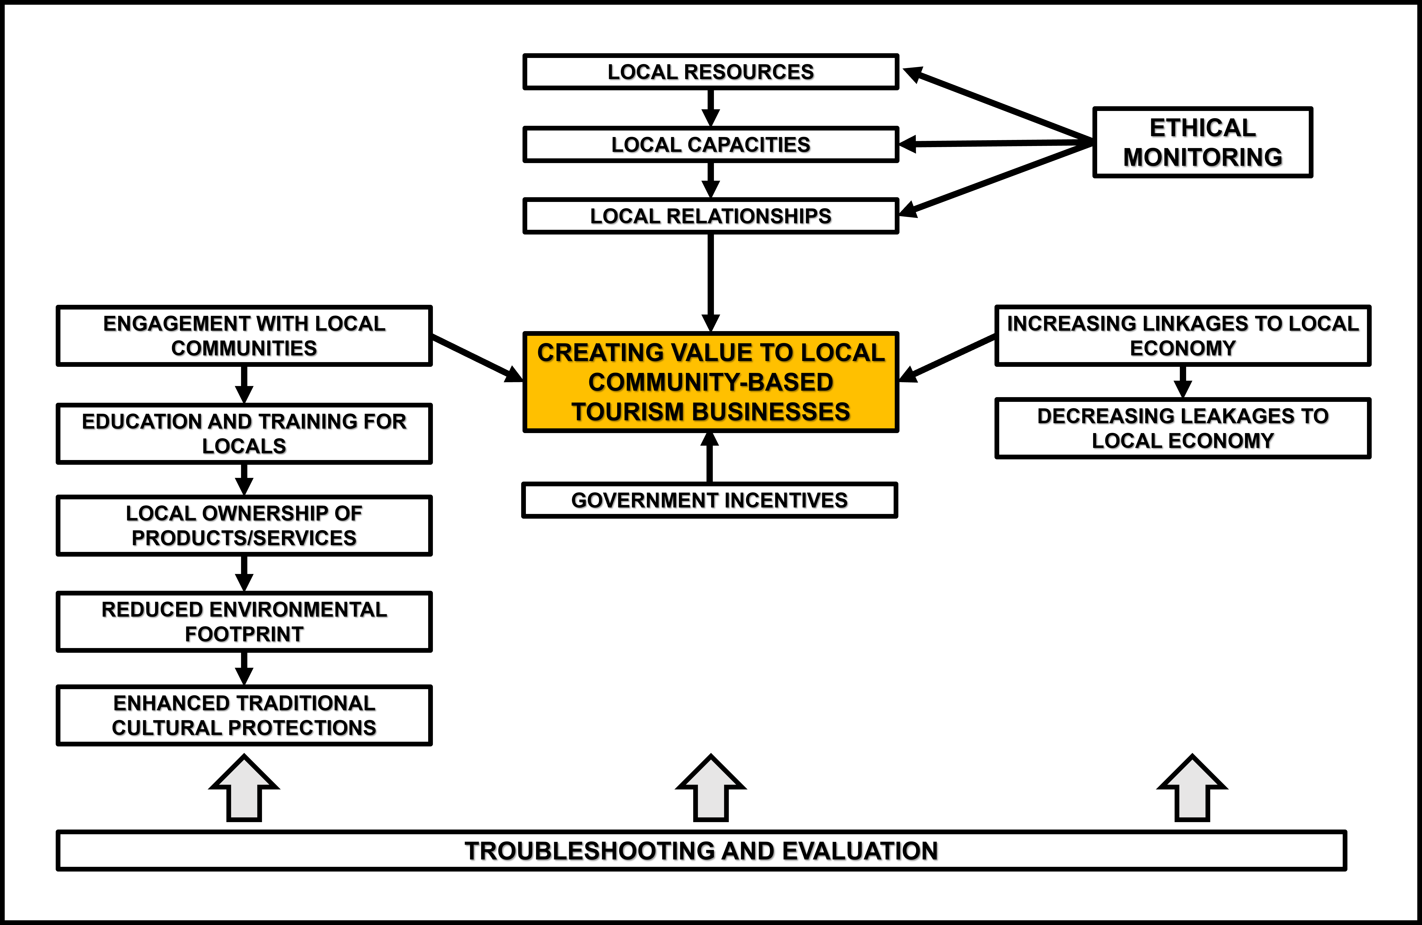
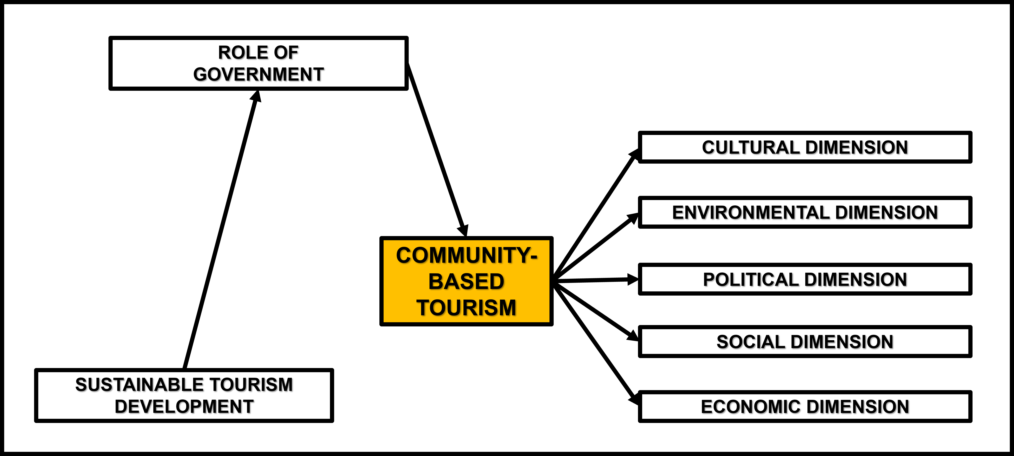
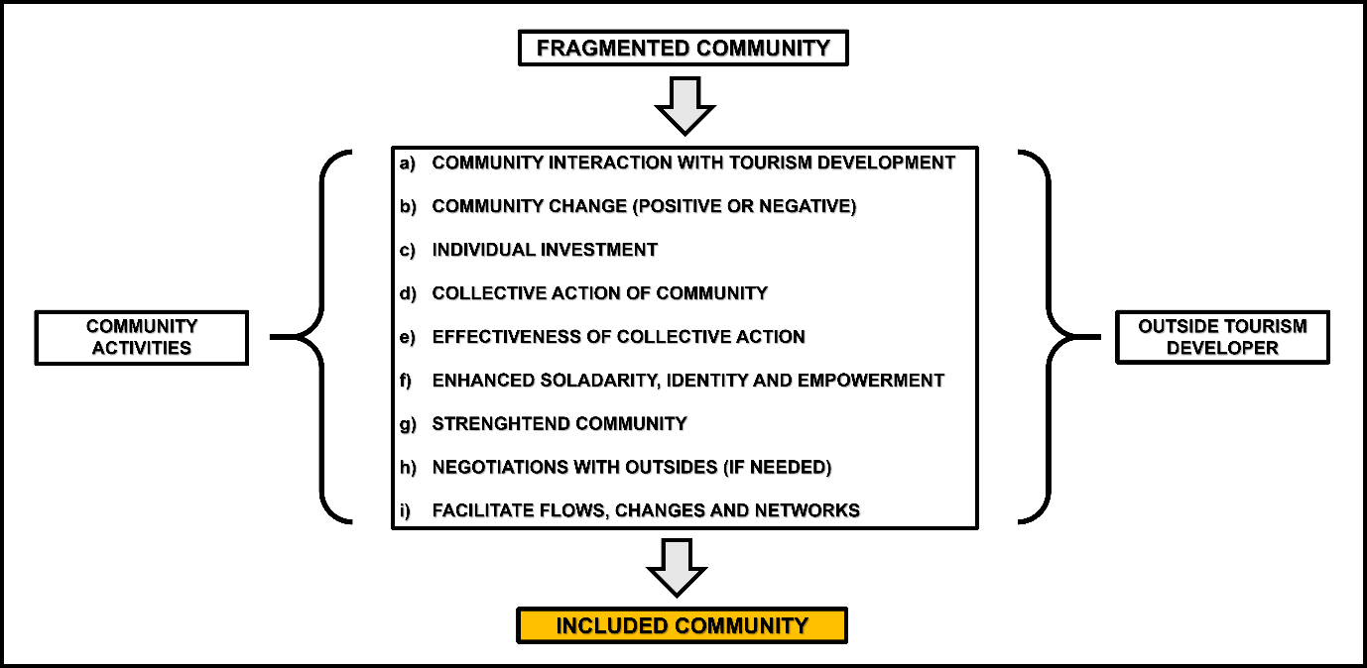
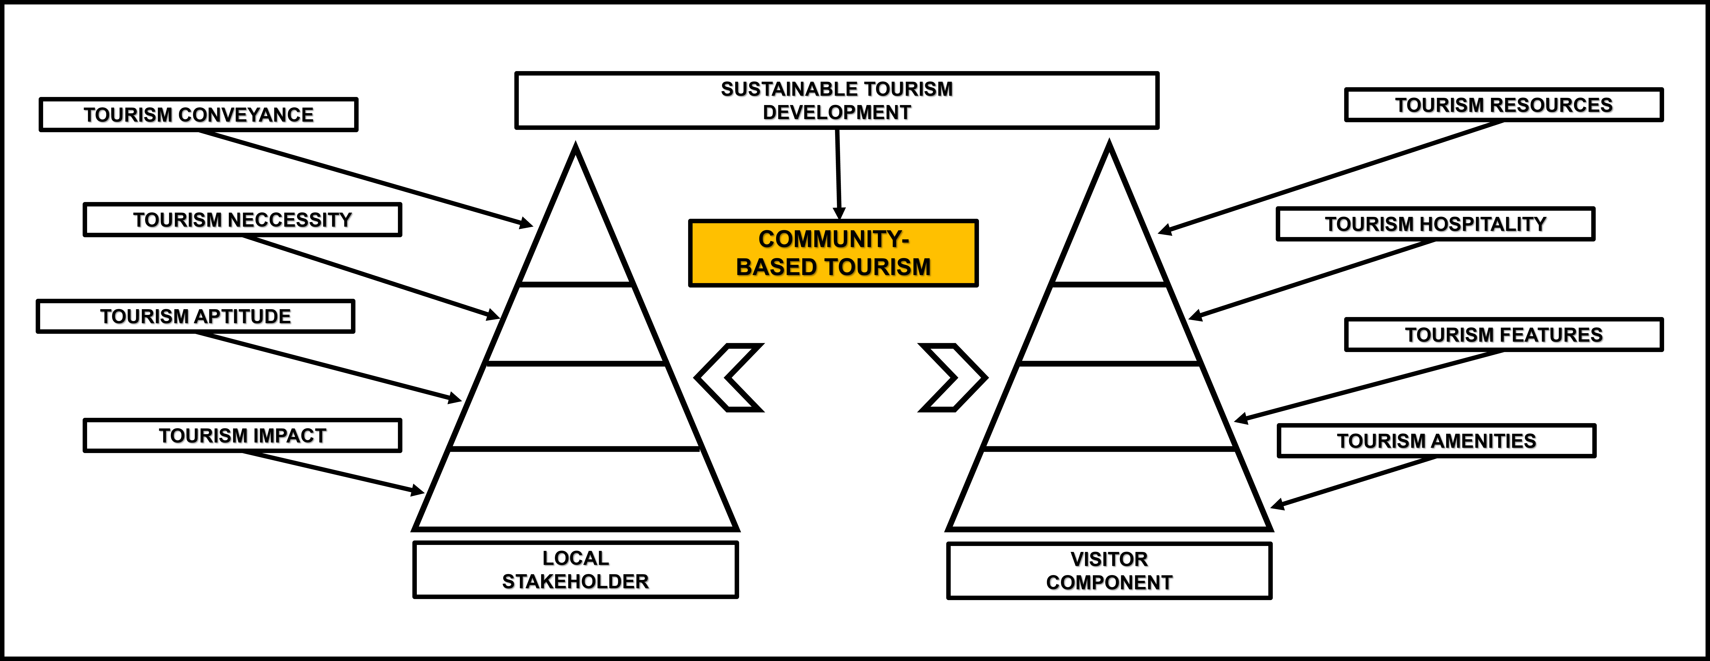
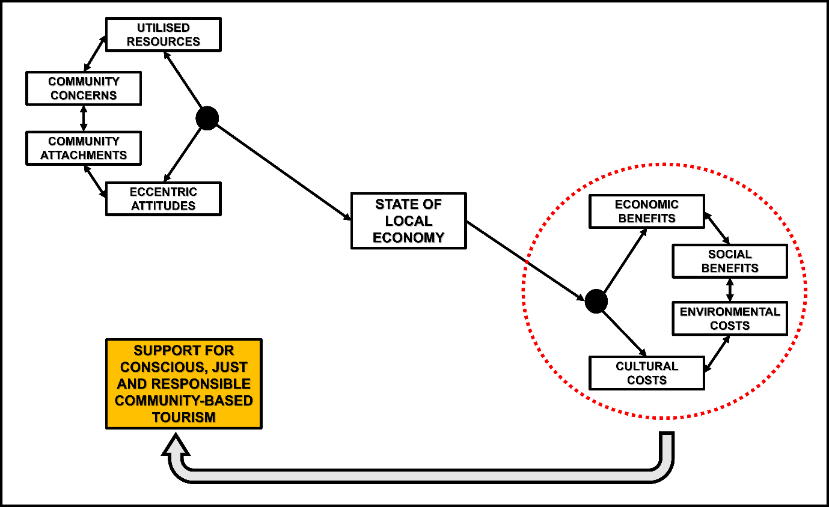
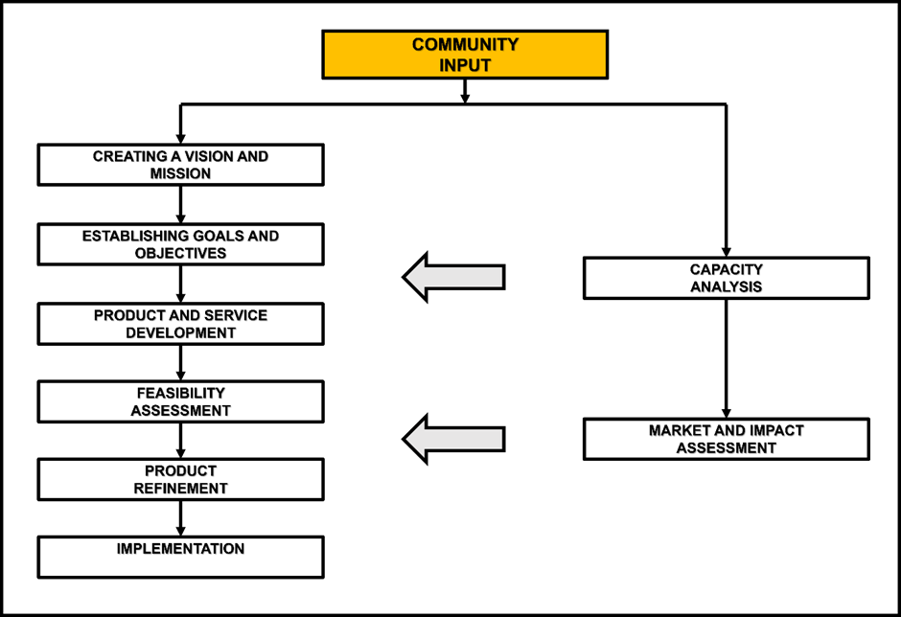
“Community-based stakeholder model”
“Community tourism planning model for marginalized destinations”
“Structural community support model for tourism”
“Community-based action model to influence tourism”
“Governance model for CBT”
“Sustainable model for CBT”
“Structural model for CBT performance”
“Model for the analysis of CBT”
“Factor analysis model for CBT”
“Structural model for sustainable community development”
G. Rose et al. (2022)
H. Han et al. (2019)
M.N.R. Llupat (2022)
N.M. Eranawati, I.B. Arjana & N.M.R. Sukmawati (2019)
J. Konwar & D.K. Chakrabarty (2014)
O. Mtapuri, M.A. Camillieri & A. Dluzewska (2021)
D. Gursoy & D.G. Rutherford (2004)
S. Harwood (2010)
D. Hwang, W.P. Stewart & D.W. Ka (2012)
I.N.R. Adi et al. (2017)

Slide 28
MODEL | COMMUNITY | GOVERNMENT | PRIVATE | FOCUS
1. Gursoy & Rutherford | X | X | X | Just, conscious and responsible
2. Harwood | √ | X | X | Capacity
3. Hwang, Stewart & Ka | √ | X | √ | Inclusion
4. Konwar & Chakrabarty | √ | X | X | Sustainable
5. Adi et al. | X | √ | X | Sustainable
6. Ernawati, Arjana & Sukmawati | X | √ | √ | Facilitation
7. Han et al. | X | X | X | Performance
8. Mtapuri, Camillieri & Dluzewska | X | √ | X | Ethical
9. Rose et al. | X | √ | X | Sustainable
10. Llupat | √ | √ | √ | Sustainable and inclusion
Notes:
In six of the ten operating models appraised, the community was not a central component; as regards government, only half of the models situated this stakeholder in a central position; while the private sector did not feature in seven of the ten instances. The importance of sustainability was apparent as was the responsible and ethical dimensions of CBT.

Slide 29
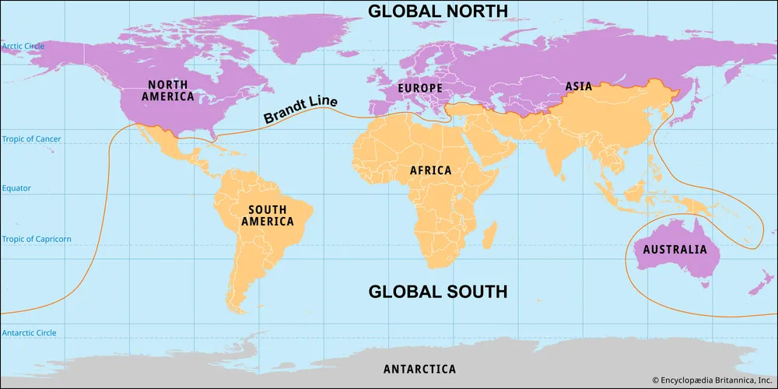
“Global South – 15 case studies”
SOUTH
AMERICA
AFRICA
ASIA
Notes:
The fifteen global South case studies analysed indicated that while community is integral to CBT, private stakeholders were apparent in six with government featuring in only two. This was not the finding in the case in the South African CBT domain.

Slide 30
“Global South - analysis”
 | Country | CBT | Start date | Operational | Key stakeholder
1 | Peru | Titikayak project: Llachon | Not specified | Yes | Community
2 | Ecuador | Termas de Papallacta | 1994 | Yes
3 | Brazil | Route to Freedom (Rota da Liberdade) project | 2005 | Yes
4 | Bolivia | Chalalan Ecolodge | 1997 | Yes | Community
5 | Peru | Posada Amazonas | 1993 | Yes
SOUTH AMERICA
 | Country | CBT | Start date | Operational | Stakeholders
1 | Malaysia | Community Based Tourism in Bario, | Late 1980s | Yes
2 | Cambodia | Chambok Eco-tourism Site | 2002 | Yes
3 | Philippines | El Nido Foundation | 1994 | Yes
4 | Thailand | Koh Yao Noi Community Based Eco-tourism Club | 1995 | Yes
5 | Cambodia | Cottage Industries Tour, Battambang | 2005 | Yes | Private
ASIA
 | Country | CBT | Start date | Operational | Stakeholders
1 | Kenya | Ngwesi lodge | 1996 | Yes | Government
2 | Namibia | Community-based natural resource management program | 1996 | Yes | Government
3 | Gambia | Ninki Nanka Trail | 2019 | Yes | -Private
4 | Uganda | Mount Gahinga Lodge | 1997 | Yes | -Private
5 | Namibia | Damaraland camp | 1996 | Yes | Community
AFRICA

Slide 31
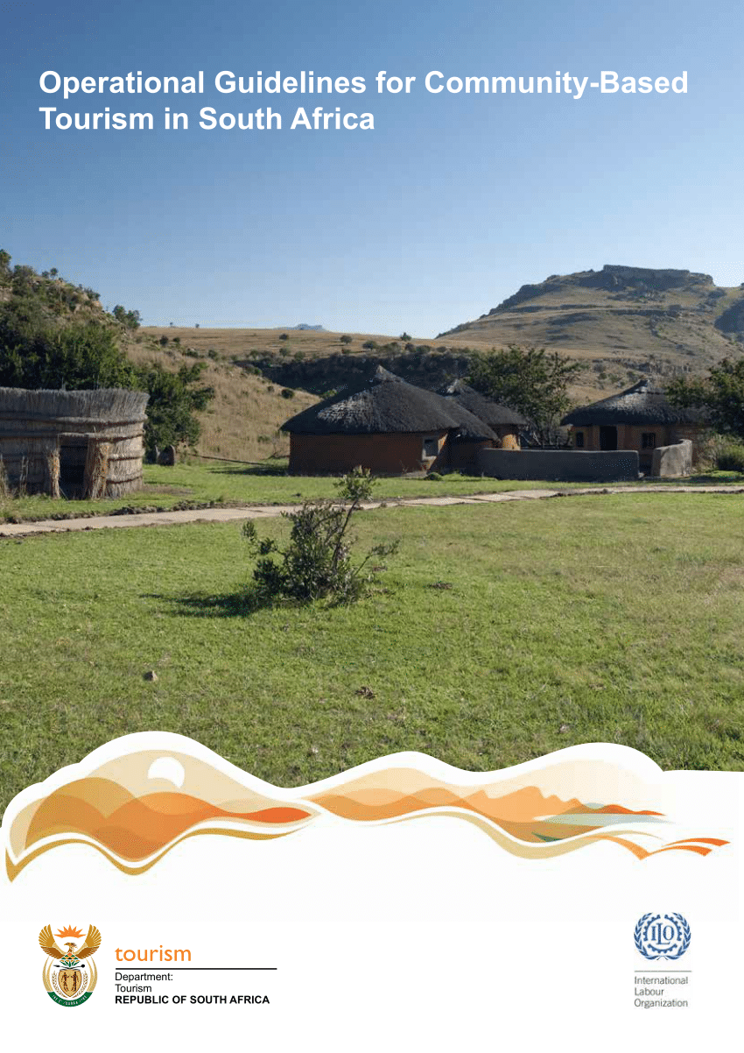
DEPARTMENT OF TOURISM
CBT MODELS
Communally-owned ventures
Community initiatives in joint ventures with the private sector
CBT entrepreneurship
Community enterprise linkages with private sector owned tourism businesses
Notes:
The Operational Guidelines also proscribe four operating models which illuminate varying positioning of the community in CBT with two advocating partnerships with the private sector. The later Framework called for the strengthening of the support for communities – an aspect which has been endorsed in South Africa’s G20 presidency, a notion called the “Alula Framework for Inclusive Community Development”.

Slide 32
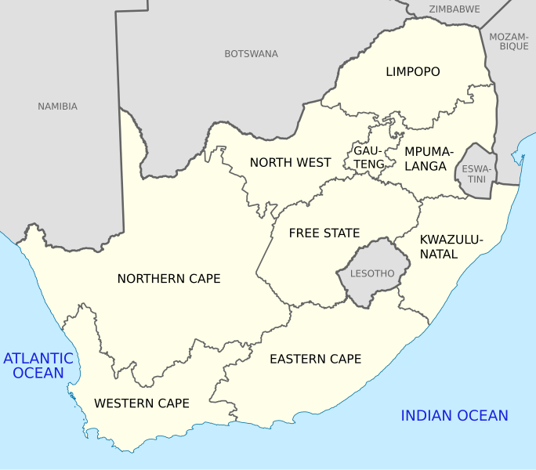
“South African – 90 case studies”

Slide 33
“South Africa - analysis”
 | City | CBT | Start date | Operational | Key stakeholder
1 | Cape Town | !Khwa ttu San Culture & Education Centre | 2002 | Yes | Private
2 | Knysna | Mothers of Creation Route | 2017 | Yes | Private
3 | Khayelitsha | Ghetto Sessions | 2017 | Yes | Community
4 | Khayelitsha | 18 Gangster Museum | 2018 | Yes | Private
5 | Franschhoek | Franschhoek Township & Village. | Unknown | Yes
6 | Langa | Guga S’Thebe Arts & Culture Centre | 1990s | Yes
7 | Cape Town | Camissa Tours | 2006 | Yes
8 | Cape Town | Veld & Sea | 2013 | Yes
9 | Uthando | Uthando | 2007 | Yes
10 | Hermanus | Hawston | 1994 | Yes
WESTERN CAPE
 | City | CBT | Start date | Operational | Key stakeholder
1 | Tweerivieren | !Xaus Lodge, Kgalagadi Transfrontier Park. | 2002 | Yes | Private
2 | Kimberley | Wildebeest Kuil Rock Art Centre | 2008 | Yes | Government
3 | Kimberley | Ke-Ditselana Tourism and Multi-Cultural Village | 2004 | Yes | Government
4 | Askham | Kalahari Desert Festival | 2013 | Yes | Private
5 | Kimberley | Native Minds Heritage Tourism | 2009 | Yes
6 | Riemvasmaak | Riemvasmaak Community Conservancy | 1994 | Yes | Government
7 | Mier | Khomani San Cultural Landscape | 2017 | Yes | Government
8 | Eksteenfontein | Nama Homestays | 2003 | Yes | Government
9 | Askham | Aunt Koera’s Roosterkoek Experience | 1999 | Yes | Private
10 | Kuruman | The Workshop ko Kasi | 2016 | Yes
 | City | CBT | Start date | Operational | Key stakeholder
1 | Hazyview | Shangana Cultural Village | 1999 | Yes | Government
2 | Bushbuckridge | Bushbuckridge Marula Route | 2018 | Yes | Government
3 | Barbeton | Mahushe-Shongwe Nature Reserve | 1996 | Yes | Government
4 | Bronkhorstspruit | Kghodwana Cultural Village | 1989 | Yes | Community
5 | Mbombela | Matsamo Customs & Tradition Centre | 2001 | Yes | Government
6 | Hazyview | Shabalala Interpretation of Culture Centre | 2023 | Yes | Government
7 | Graskop | Community Craft Centre at Graskop Gorge Lift | Unknown | Yes | Community
8 | Hazyview | Vomba Village Tours | Unknown | Yes | Private
9 | Skukuza | Kruger Cultural Village | Unknown | Yes | Government
10 | Mbombela | Mpumalanga Cultural Xperience | 2015 | Yes
NORTHERN CAPE
MPUMALANGA
Notes:
The survey of ninety South African CBT case studies revealed that although there should be a symbiotic relationship between the three stakeholders, the analysis actually pointed to the community and government being insiders and the private sector as a temporary outsider.

Slide 34
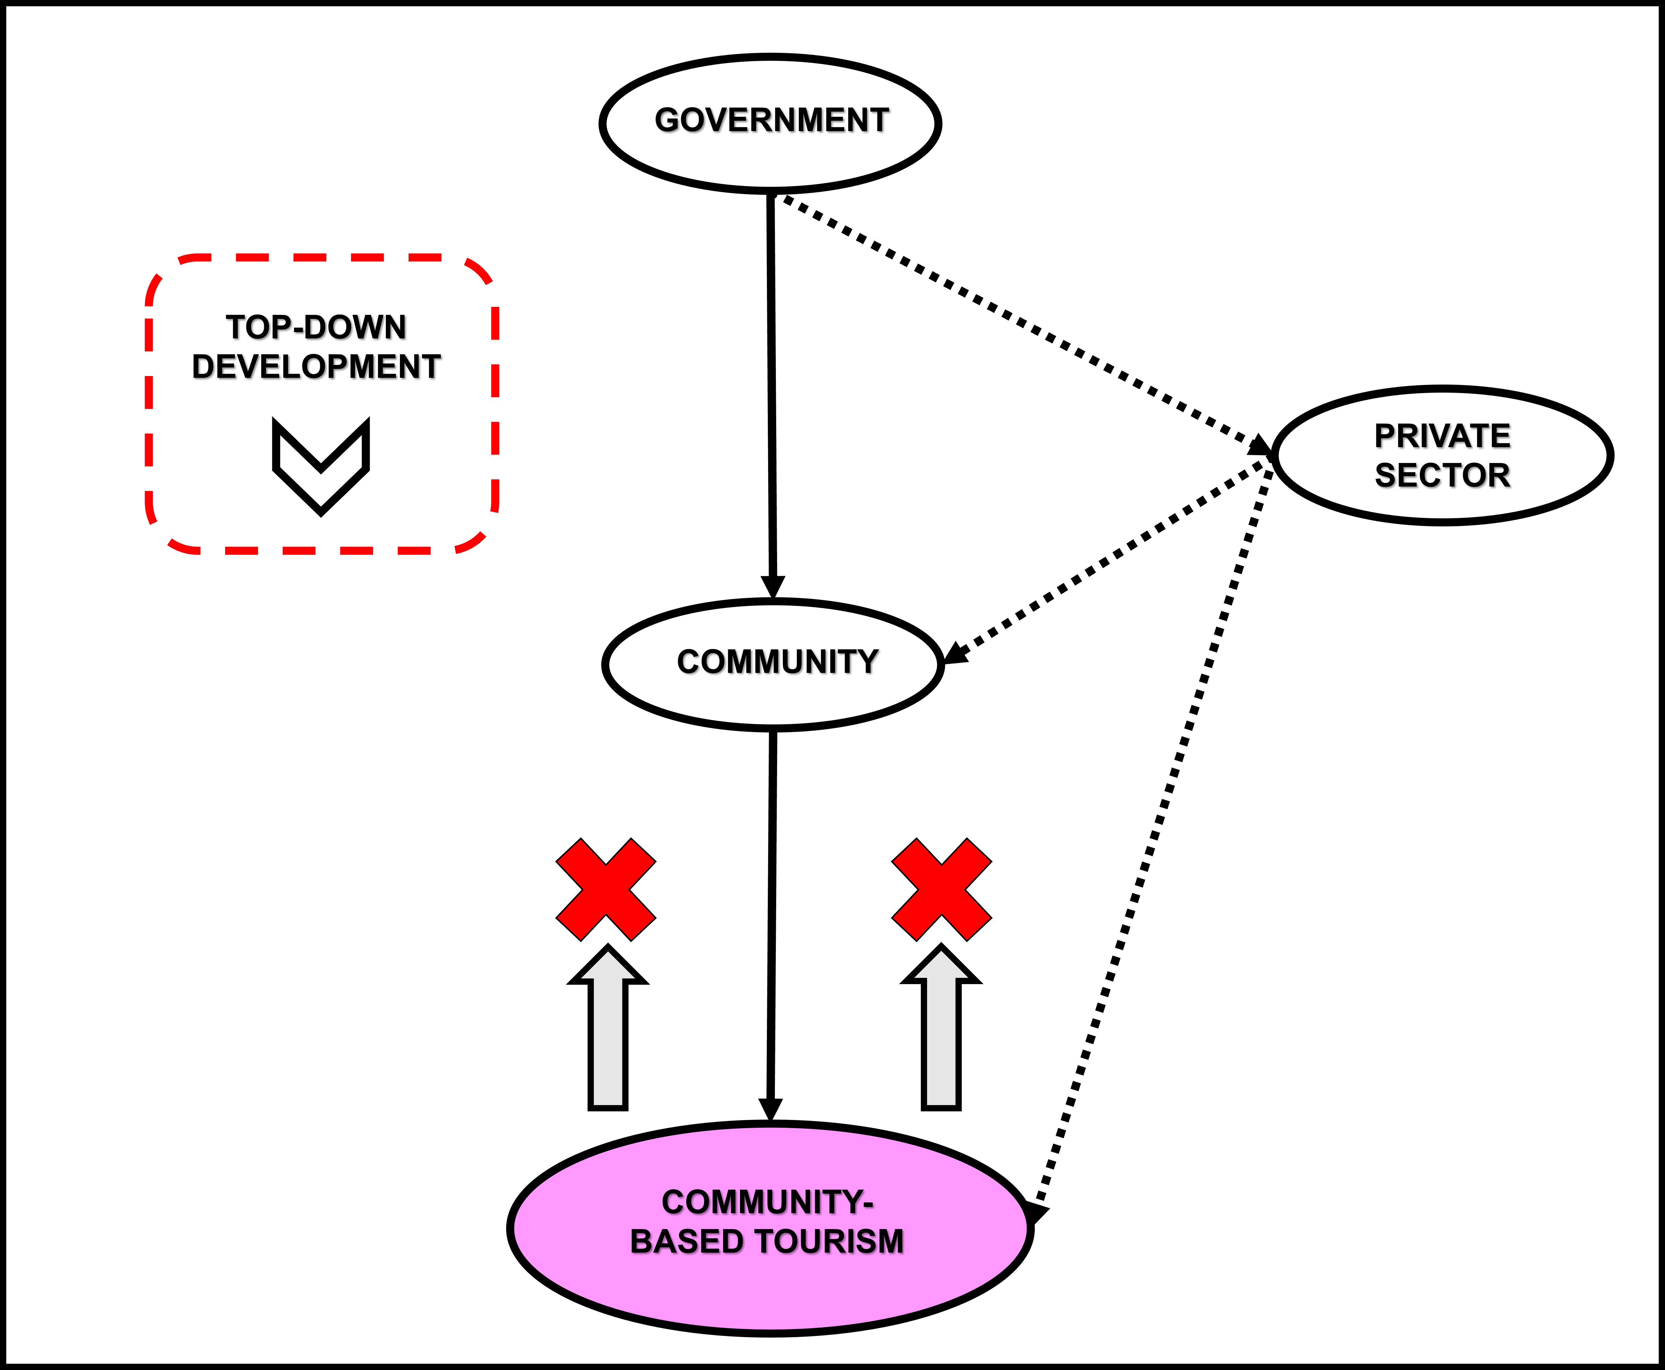
Status quo of CBT in South Africa
Notes:
Moreover, it exhibited a top-down development, from government to community, with the private sector as a tangential component resulting in a general lack of optimization of CBT.

Slide 35
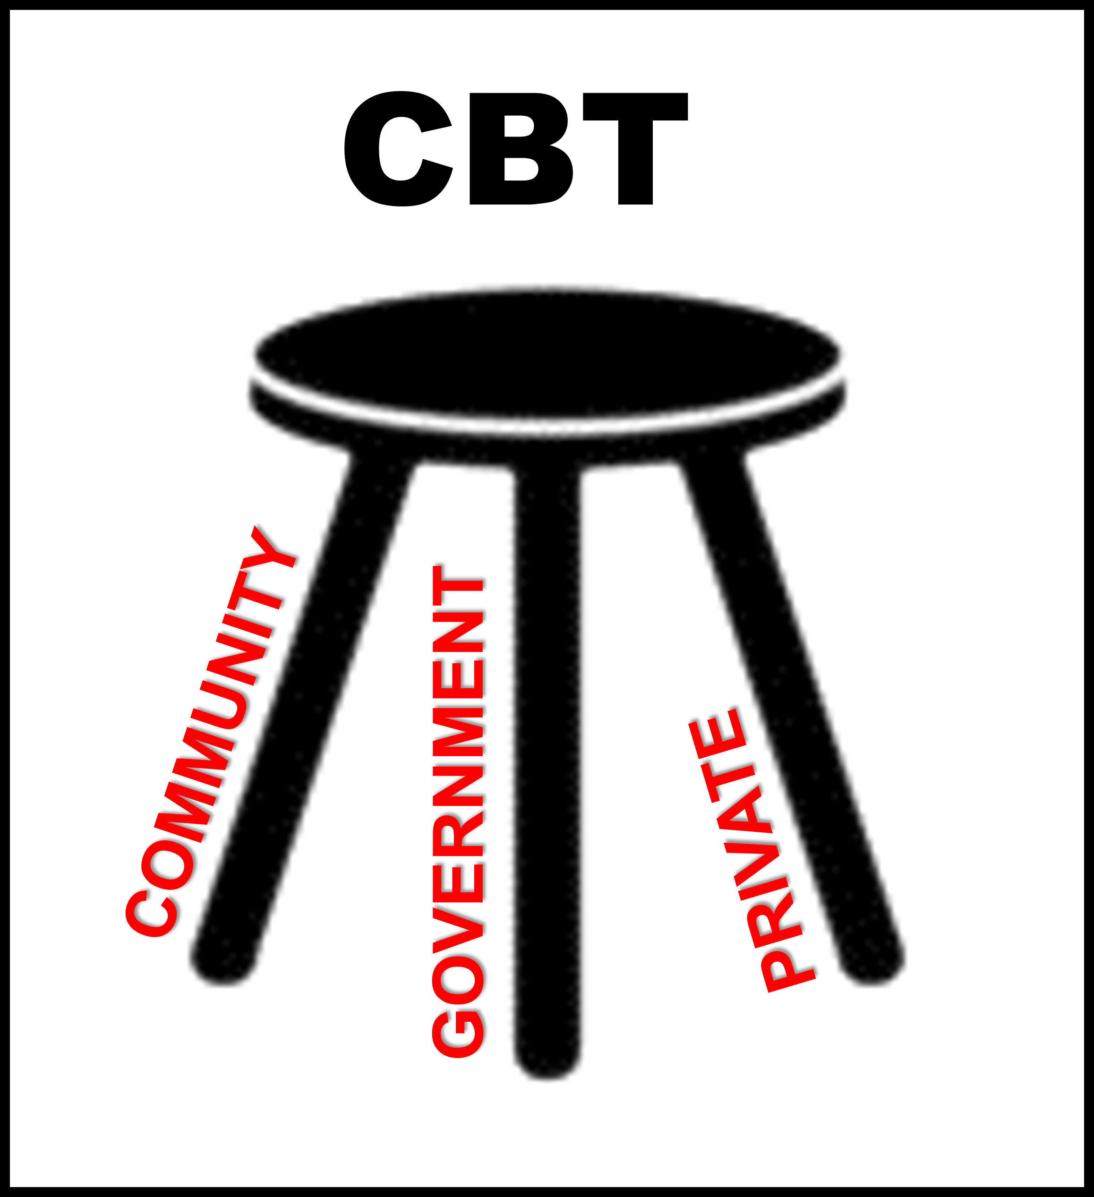
Three legs of CBT
Notes:
What becomes clearly apparent is the critical role that the three stakeholders – community, government and private – need to play in order for CBT to be optimised

Slide 36
SOLUTIONS TO OPTIMIZE SUSTAINABLE TOURISM
Solution A: Community carousal
Solution B: C-Based-T integration approach
Solution C: I-factor indicator
Notes:
Three proposed solutions for the optimization of CBT with a more sustainable option within a South African context were devised. They addressed the range of issues and challenges that the research at both international and local level highlighted. It must however be noted that these three proposed solutions for, or approaches to, are not a formula, model or recipe for CBT. Rather, they are possible solutions to address what the research has indicated are hindrances, obstacles or weaknesses in the operation and functioning of some CBT projects

Slide 37

Solution A: Community carousal

Slide 38
COMMUNITY CAROUSAL
SOCIAL
BELIEFS
LANGUAGES
COMMUNITY
DIALECTS
ECONOMIC
EDUCATIONAL
CULTURES
CUSTOMS
POLITICAL
Notes:
The first solution, the “Community carousel” is concerned with assessing the notion of “community” as a more inclusive and nuanced concept. It flags the divergent components that form part of an identified “community” within a specified location. Differences as regards culture, language, dialect, customs, and belief systems need to be acknowledged as do disparities as regards economics, politics, education and society inequalities. This is premised on the need for all members of the community to feel recognised as regards the individual preferences and to ensure that all members of the community feel included in the CBT project, in terms of minorities and majorities.

Slide 39
Solution B: C-Based-T integration approach
CBT

Slide 40
Solution B: C-Based-T integration approach
GOVERNMENT MONITORING
B
BASED
C
T
FUNDING
SKILLS
MANAGEMENT
COMMUNITY
TOURISM
SUPPLY
DEMAND
PRIVATE INPUT
Notes:
The second solution, the “C-Based-T Integration”, reassessed the component of “based” in the concept CBT proposing that, where viable, the government and private sector need to be formally integrated into CBT. This solution argues for a greater role to be apportioned to monitoring by government making all stakeholders accountable throughout the project lifespan. The private sector on the other hand needs also to be an integral part of CBT to not only provide foundational funding – with the understanding that the CBT project will eventually become profitable – but also to assist with skills development and management training component which should be perpetuated throughout. Just like the government, the private sector must be a permanent participant in CBT for it to be sustainable and successful.

Slide 41


Solution C: I-factor indicator

Slide 42
Solution C: I-factor indicator
COMMUNITY
GOVERNMENT
PRIVATE
Initiate
Ideate
Interest
Invest
Incentivise
Interact
Insure
Notes:
The third proposed solution introduced the “I-factor” into the process of operating CBT contending that all three key stakeholders are integral to the CBT project and need to be assigned specific roles both individually and in collaboration with one another. This proposed solution comprises seven elements which need to be galvanised by the three stakeholders to allow for optimum alignment, harmonious commitment and ultimate success. These elements include: initiate; ideate; interest; interact; invest; incentivise; and insure. The three key stakeholders in the CBT project need to be responsible for a number of these elements in an integrated manner which will ensure a more effective symbiosis between the various stakeholders and hopefully a more sustainable and optimised CBT domain.

Slide 43

Tourism priorities
Reigniting Demand:
Stimulating domestic demand and marketing South Africa to international leisure and business events markets.
Rejuvenating Supply:
Enhancing product quality, developing tourism infrastructure, and investing in rural areas to support sustainability and inclusivity.
Strengthening Enabling Capability:
Improving skills within the sector, developing digital platforms, and fostering strong collaboration between government, private sector, and communities.

Slide 44
Tourism priorities
Reigniting Demand:
Improved CBT
Rejuvenating Supply:
Reconfiguring community
Strengthening Enabling Capability:
Realigning the private input

Slide 45

G20 22-23 November 2025
EQUALITY - Community, government and private
SUSTAINABILITY - Community, government private
SOLIDARITY - Community, government and private

Slide 46

Prospects for future research
Engaging models with stakeholders
practical encounters
Roll out of CBT
workshops and interventions
Refining the modelling
adaptation based on feedback

Slide 47
Thank you!

