Slide 1

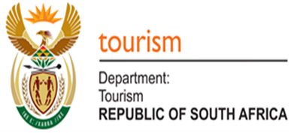
National Department of Tourism
Final Report, 2025
24th October, 2025
Assessing the management, maintenance and sustainability of State-owned Tourism Assets in South Africa
By
UKZN Research Team
Prof. Joram Ndlovu
Prof. Oliver Mtapuri
Dr. Mabuyi Gumede
Dr Taemane Phoofolo

Slide 2

Presentation Outline
Study background and objectives
Strategic Alignment
Methodology Applied in the Study
Challenges and Possible Solutions
Key Findings and Insights
Key Components of the IMSM
Actionable Recommendations
Conclusion

Slide 3
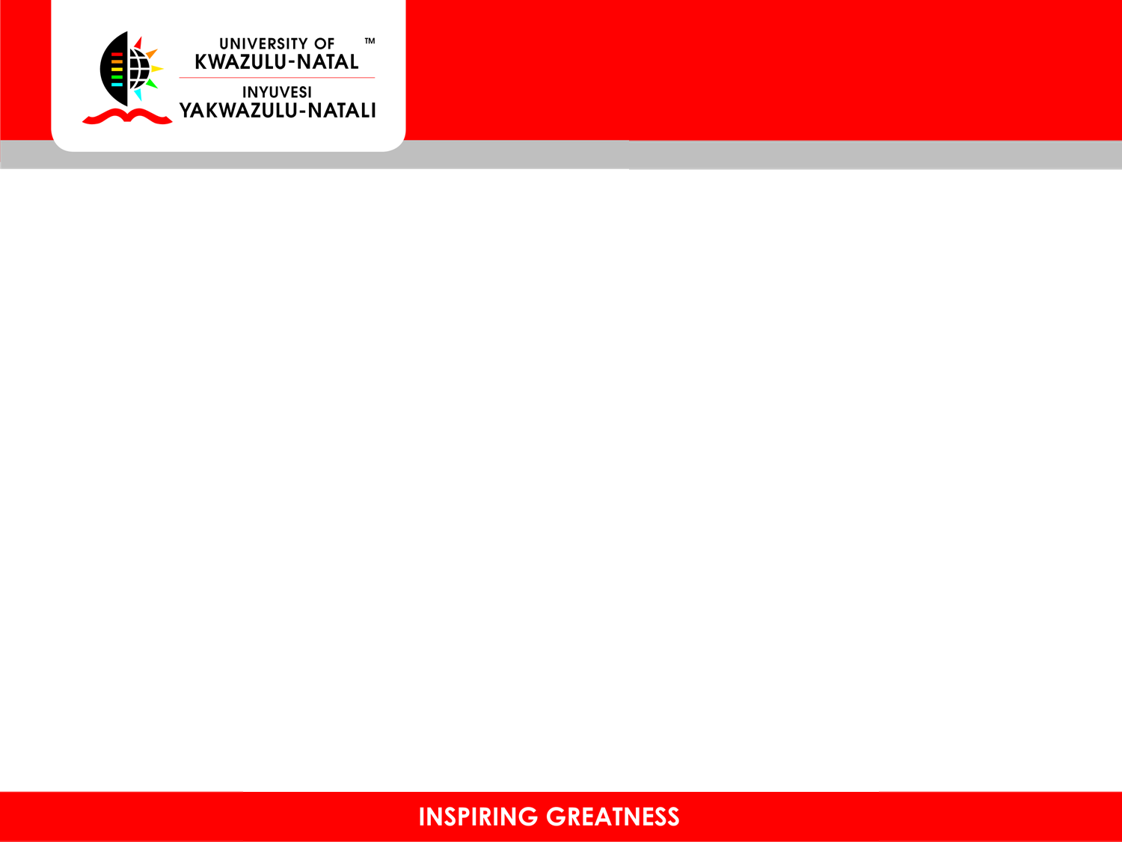
Purpose & objectives of the study
The study sought to assess the management, maintenance and sustainability of state-owned tourism assets in South Africa and identify a best-fit model that may be adopted by the government.
Identify and analyse business models on the assessment, management, maintenance and sustainability of state-owned tourism assets and establish best practices thereof.
Assess the management, maintenance and sustainability of state-owned tourism assets in South Africa with a particular focus on their contribution to income generation, job creation and local economic development.
Identify partnerships to leverage for the management, maintenance and sustainability of state-owned tourism assets in South Africa.
Provide actionable recommendations on the best-fit model for the state to adopt in order to maximise its efforts towards the management, maintenance and sustainability of state-owned tourism assets.

Slide 4
Research Methodology: A Mixed-Method Approach
Data Collection
Research Techniques
Analysis Methods
Quantitative and qualitative data
Desktop literature review (national and international)
SWOT analysis of state-owned entities
Government and Municipal officials
Sustainability Assessment Frameworks
Asset managers (parks, museums,
heritage sites)
Management models review
Socio-economic assessment
Sustainability frameworks analysis
Local communities
Environmental assessment
Stakeholder analysis
Private businesses
Trend analysis (secondary data)
Case studies (heritage sites and museums)
Environmental groups and academics
Statistical analysis (financial and performance data)
Focus group discussions (FGDs)

Slide 5
Results
Demographic Profile of Stakeholders
Age Distribution
Gender Balance
21-30 years
16.3%
Male Respondents
55.1%
31-40 years
Mid-career
Female Respondents
44.9%
41-50 years
Senior roles
Difference
10.2%
51+ years
18.4%
Balance Assessment
Inclusive
Education Level
Length of Service
Postgraduate/Honours
40.8%
Under 5 years
30.6%
Master's Degree
26.5%
5-10 years
Mid-career
PhD
8.2%
16-20 years
22.4%
Diploma/Certificate
22.4%
Over 21 years
16.3%

Slide 6

Demographic Profile of Visitors
Part 1: Age, Gender, Education & Occupation
Age Distribution
Gender Distribution
18–29 years
25.6%
Female
50.6%
30–39 years
24.4%
Male
48.9%
40–49 years
20.0%
Non-binary
0.6%
50–59 years
17.4%
Education Level
60–69 years
8.4%
Postgraduate degree
36.4%
70+ years
4.1%
Undergraduate degree
32.4%
Occupation
Secondary school
25.1%
Private/Business sector
43.7%
Primary school
3.1%
Public sector employees
16.0%
No formal education
2.9%
Students/Scholars
13.4%
Unemployed
9.7%
Retired
8.7%
Continued on next slide:
Place of residence, yearly income distribution, and comprehensive visitor composition insights.

Slide 7

Demographic Profile of Visitors
Part 2: Residence & Income
Place of Residence
Yearly Income (USD)
South Africa
41.7%
Less than $25,000
20.1%
Europe
25.1%
$25,001 – $50,000
12.4%
Africa (excl. SA)
14.6%
$50,001 – $75,000
11.6%
Americas
8.1%
$75,001 – $100,000
8.7%
Middle East
4.9%
$100,000+
5.4%
East Asia
3.7%
Market Composition & Insights
Domestic visitors dominate at 41.7%, with Europe as the second-largest source market at 25.1%. Other international regions collectively account for approximately 20% of visitors. Income distribution shows that 20.1% of visitors earn less than $25,000 annually, indicating affordability is a key factor. The combined lower three income brackets (less than $75,000) account for approximately 44.1% of visitors, while upper brackets ($75,000+) represent 14.1%, suggesting a diverse market with both budget-conscious and affluent visitor segments.

Slide 8

State-Owned Entity Categories
National Parks
32.7%
Strong emphasis on biodiversity conservation, large-scale ecotourism, and ecosystem services.
Other Categories
22.4%
Diversification and potential definitional ambiguities warranting refinement for improved accountability.
Protected Areas
14.3%
Critical buffers and community-based tourism anchors for integrated land management and co-governance.
Historical, Cultural & Heritage
Sites
10.2%
Reflecting the social dimension of tourism and the need for authentic experiences.
Stakeholder/Service Provider
12.2%
Highlighting the importance of partnerships and service quality in the tourism ecosystem.
Museums and Monuments
8.2%
Vital for cultural education and heritage preservation, requiring ongoing conservation investments.

Slide 9
Infrastructure and Accessibility
General Infrastructure
Accessibility
Trails, Maintenance & Signage
People with Disabilities
Good
38.8%
Good
30.6%
Excellent
20.4%
Excellent
28.6%
Fair
24.5%
Fair
16.3%
Poor
16.3%
Poor
24.5%
Key Finding
Key Finding
Budgetary constraints and funding gaps are primary drivers of deterioration. Focused maintenance plan with adequate budgeting is required to restore exellence.
Infrastructure needs enhancement to support safe, hassle-free travel and reliable access to tourism infrastructure, water, and sewage systems.

Slide 10

Cleanliness, Hygiene, and Safety Findings
Cleanliness
Safety
Emergency
Absence of Litter
Absence of Crime
Preparedness & Response
Good
36.7%
Good
34.7%
Good
32.7%
Excellent
30.6%
Excellent
28.6%
Excellent
24.5%
Fair
28.6%
Fair
22.4%
Fair
26.5%
Poor
Poor
Poor
4.1%
14.3%
16.3%
Finding
Finding
Finding
Minimal litter in most facilities. Revamp needed across public spaces.
34.7% present crime prevention initiatives. Enhanced security measures are needed for visitor confidence.
32.7% need enhancement. Improving emergency protocols is crucial for visitor safety and operational resilience.
Ablution Facilities
Security Personnel
Overall Assessment
Good
38.8%
Good
36.7%
While most areas maintain good standards (34.7% for crime, 36.7% for security), significant portions require targeted improvements to enhance visitor confidence and operational safety.
Excellent
22.4%
Excellent
26.5%
Fair
20.4%
Fair
20.4%
Poor
18.4%
Poor
16.3%
Finding
Finding
38.8% require improvement. Addressing fair and poor categories crucial for visitor satisfaction.
36.7% need improvement. Strengthen personnel presence and surveillance systems.

Slide 11

Environmental Sustainability Findings
Waste Management & Recycling
Energy Efficiency & Conservation
Water Conservation & Management
Good
30.6%
Good
28.6%
Good
32.7%
Excellent
26.5%
Excellent
24.5%
Excellent
22.4%
Fair
24.5%
Fair
26.5%
Fair
24.5%
Poor
18.4%
Poor
20.4%
Poor
20.4%
Key Finding
Key Finding
Key Finding
30.6% requires improvement. Enhanced waste management and recycling initiatives are vital for environmental protection.
28.6% needs enhancement. Improving energy efficiency is crucial for reducing environmental impact and promoting sustainable operations.
32.7% requires improvement. Enhanced water conservation is vital for sustainable resource use and environmental resilience.

Slide 12

Economic Viability and Community Engagement
Economic Viability
Revenue Generation & Financial Sustainability
Job Creation & Local Economic Impact
Investment & Funding Opportunities
Good
34.7%
Good
28.6%
Good
30.6%
Excellent
24.5%
Excellent
20.4%
Excellent
20.4%
Fair
20.4%
Fair
26.5%
Fair
26.5%
Poor
20.4%
Poor
24.5%
Poor
22.4%
Community Engagement
Local Community Involvement
Cultural Preservation & Promotion
Visitor Education & Awareness
Good
32.7%
Good
30.6%
Good
34.7%
Excellent
22.4%
Excellent
24.5%
Excellent
26.5%
Fair
24.5%
Fair
26.5%
Fair
20.4%
Poor
20.4%
Poor
18.4%
Poor
18.4%
Key Insights
Economic viability shows mixed results with 48.9% rating revenue generation as fair to poor. Community engagement presents opportunities, with 61.2% rating visitor education as good to excellent. Strategic focus needed on financial sustainability, investment attraction, and enhanced community involvement to maximize tourism's socio-economic benefits.

Slide 13

Key Insights and Strategic Recommendations
Financial Performance
Recommendation
48.9% of respondents rated revenue generation and financial sustainability as fair to poor, indicating significant challenges in financial viability.
Develop enhanced financial strategies including diversified revenue streams, improved pricing models, and cost optimization measures.
Local Economic Impact
Recommendation
While 59.2% of areas showed positive economic contributions, 40.8% require improvement in job creation and local economic impact.
Implement targeted programs to boost local economic contributions through skills development, local supply chain integration, and community enterprise support.
Investment and Funding
Recommendation
Over 51% of respondents rated investment and funding opportunities as fair to poor, highlighting critical challenges in securing resources for infrastructure development.
Explore diverse funding mechanisms including public-private partnerships, tourism taxes, concession revenues, and international development finance.
Marketing and Promotion
Recommendation
40.8% of respondents rated marketing and promotion as minimum or poor, suggesting weak market segmentation, poor brand positioning, and ineffective campaigns.
Revamp marketing strategies with improved market segmentation, enhanced brand positioning, targeted digital campaigns, and data-driven analytics.
Governance and Resource Allocation
Recommendation
The municipality faces financial crises resulting in inconsistent maintenance. There is a need for transparent governance and equitable benefit-sharing.
Establish clear governance frameworks, transparent public reporting, dedicate tourism revenues to maintenance, and implement user fees tied to conservation outcomes.

Slide 14

Challenges and Concerns
1
Weak Integration and Limited Accessibility
State-owned tourism assets lack integration with national and regional networks, limiting market reach and collaborative opportunities for sustainable development.
2
Diversity, Fragmentation, and Complexity
The diversity and fragmentation of state-owned tourism assets present significant challenges regarding the framework for planning and management, hindering coordinated policy implementation.
3
Government Silos and Multi-Level Coordination
The relationship between different layers of government (national, provincial, and local) creates silo effects, reducing coordination effectiveness and leading to duplicated efforts or gaps in service delivery.
4
Poor Transport Networks in Remote Areas
Limited and deteriorating transport infrastructure in remote areas affects the flow of tourists and market integration, reducing accessibility to tourism assets and limiting economic benefits.
5
Local Deterrents and Safety Concerns
Visitors are often deterred by local conditions including potholes, crime, safety and security issues, which undermine the visitor experience and discourage repeat visitation and tourism growth.

Slide 15

Integrated Management and Sustainability Model (IMSM)
Strategic Alignment with G20 Tourism Priorities
Sustainability
Innovation
Solidarity
Equality
Protected areas remain essential to sustainability, but their future hinges on our ability to adapt to rising pressures from tourism, social change, and conflict.
Traditional carrying capacity models fall short in capturing the complexity of tourism dynamics. Modern approaches are essential.
Effective planning requires embracing diversity, collaboration, and adaptive management across all stakeholder groups and governance levels.
By adopting the IMSM, government can maximize tourism and its socio-economic benefits while preserving the integrity of tourism assets.
Priority
Priority
People-Centred AI and Innovation
Priority
Priority
Enhanced Resilience
Collaborative Governance
Tourism Financing & Investment
IMSM Framework for State-Owned Tourism Assets
The Integrated Management and Sustainability Model provides a comprehensive framework for managing state-owned tourism assets in South Africa. It integrates environmental conservation, social responsibility, economic viability, and governance excellence to create sustainable tourism destinations.
Environmental Stewardship:
Balancing biodiversity conservation with tourism development
Social Equity:
Ensuring equitable benefit-sharing with local communities
Economic Viability:
Achieving financial sustainability and long-term investment
Governance Excellence:
Transparent, accountable, and adaptive management systems

Slide 16
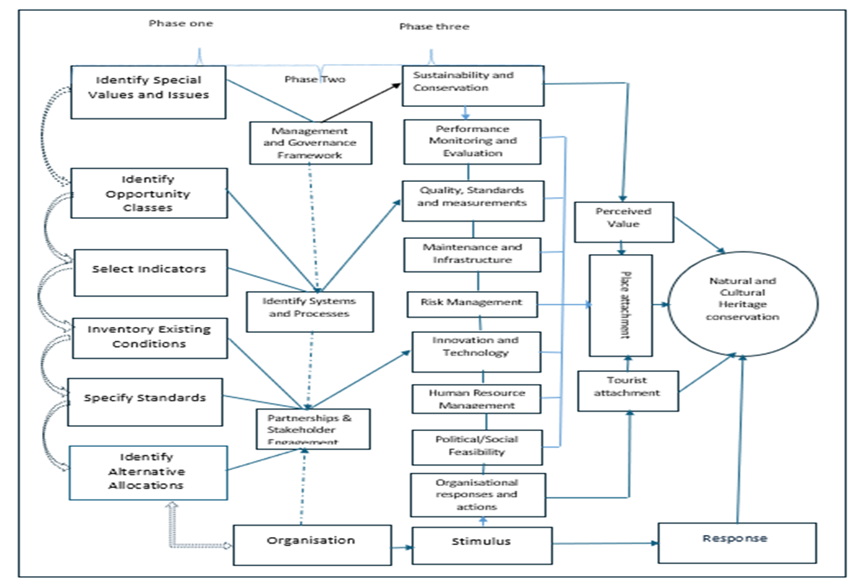

Slide 17
Conclusion and Key Takeaways
Part 1
This comprehensive study highlights critical areas for improvement in the management and sustainability of state-owned tourism assets in South Africa. By addressing financial, infrastructural, environmental, and social challenges through strategic recommendations and the proposed Integrated Management and Sustainability Model (IMSM), the government can significantly enhance the sector's long-term viability and contribution to the economy.
Key Takeaways
Financial Sustainability
Infrastructure Investment
Enhanced financial strategies and diversified revenue streams are essential for long-term viability of state-owned tourism assets.
Focused maintenance planning with adequate budgeting is required to restore and maintain safe, accessible tourism facilities.
Environmental Stewardship
Community Partnership
Integrated environmental management practices are vital for sustainable tourism that preserves natural and cultural heritage.
Meaningful community engagement and equitable benefit-sharing are essential for sustainable and inclusive tourism development.
Continued on next slide:
Next steps for implementing the IMSM framework and establishing continuous monitoring mechanisms.

Slide 18
Implementation and Continuous Monitoring
Next Steps for Sustainable Growth
Next Steps for Implementation
1
Adopt the IMSM Framework
Integrate the proposed Integrated Management and Sustainability Model into national and provincial tourism policies and strategic plans.
2
Establish Governance Structures
Create clear governance frameworks with transparent reporting mechanisms and equitable benefit-sharing arrangements.
3
Implement Continuous Monitoring
Establish quarterly monitoring and evaluation mechanisms to track asset condition, visitor numbers, economic impacts, and environmental indicators.
Continuous Monitoring and Evaluation
Regular assessment and adaptive management are essential for responding to evolving pressures and ensuring sustainable growth of South Africa's state-owned tourism assets. The success of this initiative depends on commitment to evidence-based decision-making and collaborative stakeholder engagement.

Slide 19
Limitations
Limited access to internal state data due to confidentiality, which constrains comparisons across sites.
Inadequate accessible data collection methods (e.g., surveys not available in braille, sign language, or easy-to-read formats).
Different forms of accessibility were not measured, and the online surveys were inaccessible to screen readers.
Small or non-representative samples due to limited access to populations living with disabilities.
The study did not explore in depth the accessibility of state-owned assets by people with different forms of disability.
Low return rate for the stakeholders surveys due to the use of online surveys.

Slide 20

Thank you!

