Slide 1
TOURISM SMME DIGITAL TECHNOLOGY ADOPTION IN SOUTH AFRICA: PATHWAYS FOR INNOVATION, GROWTH AND SUSTAINABILITY
Prof Tembi Tichaawa, Prof Vyasha Harilal, Dr Mavis Mpotaringa, Mrs Maisa Adinolfi & Dr Refiloe Lekgau

Slide 2
Introduction and background
Technological advancement and digitalization within the tourism economy have become increasingly important cornerstones for the continued development and growth of the sector (Curlin et al., 2024).
The many technologies available for use within the tourism sector have transformed tourism, with a shift towards digitising tourism products and services (Chamboko-Mpotaringa & Tichaawa, 2021a).
Within the South African context, tourism is a key sector for socio-economic growth and development and has been earmarked as a national priority (Harilal & Nyikana, 2019).
Historically, tourism destinations are dominated by SMMEs, which provide a wide range of products to tourists, such as accommodation, catering, transportation, attractions, and activities (Nguza-Mduba, 2023).
Additionally, within the local context, SMMEs in the tourism sector are extremely significant (Lewis et al., 2021), given their role in opportunity and employment creation, through the advancement of tourism-related entrepreneurship (Sixaba & Rogerson, 2023; Mokoena & Liambo, 2023), thus facilitating the transformation of the sector into a more inclusive one

Slide 3
Rationale, aim and objectives
Aim of the study
To investigate the tourism SMME digital technology adoption landscape in South Africa and the potential innovation opportunities to enhance their development, growth and sustainability. .
Objectives of the study:
Describe the tourism SMME digital technology adoption landscape in South Africa
Examine potential benefits and challenges related to digital technology adoption by tourism SMMEs
Determine digital technology applications that may be leveraged to enhance SMME business processes in order for them to thrive
Determine the digital technology infrastructure requirements that may enable the development growth and sustainability of tourism SMMEs
Assess and outline clear innovation opportunities and potential partnerships to be fostered for tourism SMME growth and sustainability
Provide practical recommendations on enablers of digital technology adoption for SMME sustainability
Rationale of the study
The role of digital transformation and innovation has emerged as a critical factor influencing the competitiveness and sustainability of businesses in the tourism sector.
However, despite the growing recognition of the importance of digitisation of SMMEs in the tourism sector, they still face obstacles in effectively implementing and leveraging digital technologies to enhance their competitiveness and sustainability.
As such there is a need to investigate the tourism SMME digital technology adoption landscape in South Africa and the potential innovation opportunities to enhance their development, growth and sustainability

Slide 4
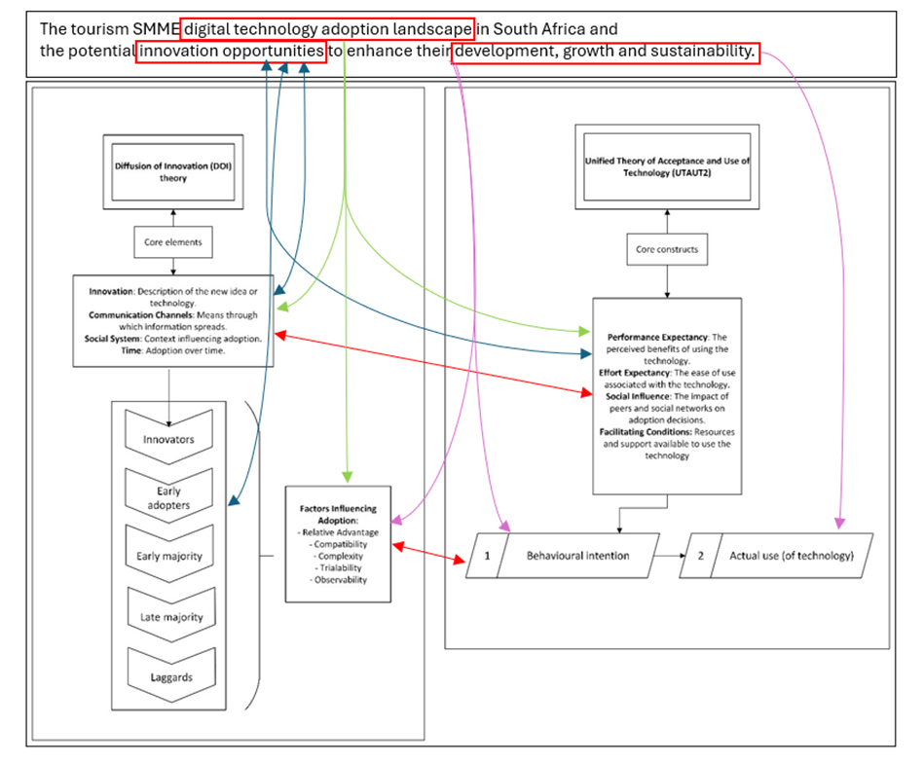
Theoretical background
The proposed theoretical underpinning for this research will be drawn from the Diffusion of Innovation (DOI) theory, as well as the Unified Theory of Acceptance and Use of Technology (UTAUT2).
The Diffusion of Innovation (DOI) theory explains how new ideas, technologies, and practices spread within and between societies (Dibra, 2015), and focuses on the processes through which innovations are communicated, adopted, and integrated into social systems. This theory provides valuable insights into how and why certain innovations succeed while others fail.
The Unified Theory of Acceptance and Use of Technology (UTAUT2) is an extension of the original UTAUT model, developed to provide a comprehensive framework for understanding how individuals accept and use technology. It is particularly useful for understanding technology adoption in consumer settings, such as mobile applications, online services, and smart devices; as well as provides a nuanced view that incorporates not only practical considerations (like performance and effort) but also emotional factors (like enjoyment) and economic evaluations (like price value)
By integrating the aforementioned components, the UTAUT2 offers a comprehensive framework that helps researchers and practitioners understand the multifaceted nature of technology acceptance - which is a key component of this research
In terms of scope and application to the current study the DOI is broader, focusing on the overall diffusion process across social systems (Rogers et al., 2014), while UTAUT2 zeroes in on user acceptance and the specific reasons individuals decide to use a technology (Venkatesh et al., 2016).

Slide 5
SMMEs in South Africa
Definition of SMMEs in South Africa
Legal Framework: Defined by the National Small Business Act (1996, amended 2003, 2004, 2024), categorizing businesses based on employees, turnover, and gross assets.
Key Categories:
Survivalist Enterprises: Informal, no employees, turnover below VAT threshold, subsistence businesses.
Micro Enterprises: <10 employees, turnover <R15 million; includes small-scale guesthouses and local tour operators.
Small Enterprises: 10-50 employees, turnover between R15 million and R60 million; includes boutique hotels and restaurants.
Medium Enterprises: 51-200 employees, turnover between R60 million and R220 million; includes larger hotels and lodges.
Key Policies:
  National Tourism Sector Strategy (NTSS) and National Development Plan (NDP) prioritize tourism SMMEs for job creation and economic development (Department of Tourism, 2017; National Planning Commission, 2012).
  Tourism Enterprise Partnership (TEP) and Tourism Transformation Fund support previously disadvantaged groups in tourism (Rogerson, 2005).
Strategic Focus:
  Access to Finance: Government-backed funding (e.g., SEFA, IDC) for more flexible loans (Fatoki, 2014).
  Regulatory Reform: Simplification of business registration and compliance (National Planning Commission, 2012).
  Infrastructure Development: Focus on improving infrastructure in rural areas (Rogerson, 2018).
Key Institutions:
  DSBD: Leads small business policy development (Department of Small Business Development, 2019).
  SEDA: Offers non-financial support like mentoring and training (SEDA, 2019).
  SEFA: Provides financial support through loans and guarantees (Fatoki, 2014).
  BBSDP: Supports black-owned small businesses (Department of Trade and Industry, 2018).
  TEP: Focuses on tourism SMMEs with capacity-building programs and market linkages (Rogerson & Rogerson, 2020).
Challenges:
  Implementation Gaps: Bureaucratic inefficiencies, corruption, and lack of coordination delay support (Rogerson & Rogerson, 2021).
  Access to Finance: Complex application processes and high borrowing costs (Fatoki, 2014).
  Regulatory Burden: Compliance with tax, labour laws, and sector-specific standards is difficult for small businesses (Rogerson, 2018).

Slide 6
Tourism SMMEs in South Africa: Key Drivers of Economic Growth and Inclusive Development
Economic Importance: SMMEs play a pivotal role in South Africa's economy, especially post-apartheid, contributing significantly to economic growth, job creation, and poverty alleviation (Maziriri & Chivandi, 2020; Rogerson, 2004).
Tourism Sector: Tourism is crucial, contributing 8.2% to GDP and providing 8.8% of jobs in 2023 (WTTC, 2024). Around 95% of tourism enterprises are SMMEs (Rogerson & Rogerson, 2020).
Key Areas of Impact: These enterprises span across accommodation, transport, food, and entertainment, fostering inclusive growth for marginalized groups (Black South Africans, women, rural communities) and contributing to local economic development (LED).
Challenges: Despite their significance, tourism SMMEs face growth barriers, including lack of tailored support, limited resources, and socio-economic challenges.
Access to Finance: Difficulty in securing capital due to stringent bank requirements and tourism’s high-risk perception. Many SMMEs rely on personal savings or informal loans, limiting growth potential (Fatoki, 2011; Moagi et al., 2021).
Market Access: Limited access to markets and inadequate marketing capabilities, including underuse of social media and digital platforms. Digital literacy remains a barrier (Cant, 2012; Sheik, 2023).
Human Resource Capacity: Limited access to skilled labor, affecting service quality, especially in rural areas with few training opportunities (Adinolfi et al., 2018; Nicolaides, 2020).
Systemic Issues: Poor infrastructure, regulatory challenges, and seasonal demand fluctuations further hinder growth (Enwereji, 2023; Harilal & Nyikana, 2019).

Slide 7
Digital Technology and Innovation in Tourism SMMEs
Importance of Digital Technology:
Digital tools like ICTs, e-commerce, social media, AR/VR, and the metaverse have become essential for tourism SMMEs, especially post-COVID-19 (Thomas, 2024).
These technologies help adapt to changing consumer demands and provide new opportunities for business growth (Majeed et al., 2020).
Impact on Tourism:
Digital innovations like Central Reservation Systems (CRS) and Global Distribution Systems (GDS) have long been pivotal in tourism (Dhaigude et al., 2016).
Digital tools improve customer journey through seamless communication, real-time booking, and personalized experiences (Tsourgiannis & Valsamidis, 2019).
Opportunities:
Global reach and enhanced customer engagement through tailored recommendations and interactive guides (Chamboko-Mpotaringa & Tichaawa, 2023).
Data analytics enable personalized travel experiences, better decision-making, and operational efficiencies, boosting profitability (Majeed et al., 2020; Li et al., 2022).
Challenges:
Financial Constraints: High technology costs and limited funding (Sibiya et al., 2023).
Lack of Expertise: Insufficient technical knowledge and staff resistance to digital changes (Cheng et al., 2023).
Infrastructure Issues: Poor Internet connectivity, particularly in rural areas, hampers effective digital implementation.
The Importance of Digital Adaptation for Tourism SMMEs
Digital Transformation in Tourism:
Online platforms, social media, digital payments, and mobile apps are reshaping customer interactions (Schegg & Stangl, 2017).
Digital technologies offer SMMEs improved market reach, operational efficiency, and customer engagement (Rogerson & Rogerson, 2020).
Opportunities for Growth:
Social media platforms like Instagram, Facebook, and TripAdvisor help micro enterprises reach global customers affordably (Rogerson, 2019).
Digital tools can help informal businesses formalize, access financial services, and engage in government programs (Mametja et al., 2023).
Post-COVID Digital Resilience:
The pandemic accelerated the shift to digital, emphasizing the importance of digital resilience for tourism SMMEs' recovery and growth (Rogerson & Rogerson, 2021).
Digital technologies have become key for adapting to changing travel trends and ensuring future success.

Slide 8
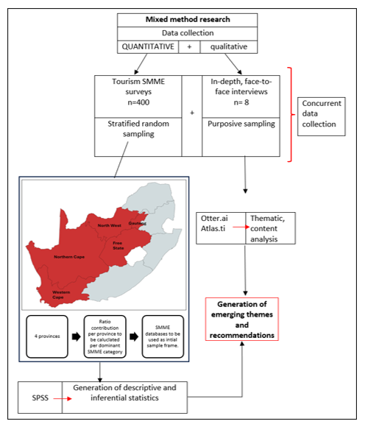
Research methodology
This study adopted a case study approach to ensure a diverse context, which provides comparative insights, policy relevance, aligning with South Africa’s development goals and a holistic understanding of the research phenomenon.
Western Cape and Gauteng were selected as leading provinces in GDP contribution, better infrastructure and higher technology adoption, North West as the moderate and Free State and Northern Cape as the lower contributors.
The study employed a mixed-methods research design.
The combination of quantitative and qualitative approaches provides multiple perspectives on the digital landscapes of the tourism SMMEs in South Africa and how to foster the digital transformation of these enterprises for sustained and resilient growth.
Following a quantitative dominant mixed methods design and being conducted in three phases, the first phase of the research constituted a systematic literature review to understand the current digital technological adoption landscapes by tourism SMMEs, the second phase entails the collection of quantitative data, and the last phase, currently ongoing, is the collection of qualitative data.
Ethical clearance was applied for and obtained before data collection commenced

Slide 9
Research methodology cont.
Quantitative approach
The first population group of this research is formal (registered) tourism SMMEs in South Africa.
The researchers used a combination of stratified, purposive, (selection based on SMME category) and snowball sampling.
In total, 400 surveys were collected.
The quantitative data collected from the questionnaires has been captured and analysed using the Statistical Package for Social Sciences (SPSS) software.
Qualitative approach
The population of the qualitative aspect of the study includes key informants working in both the private and public sectors, including the government departments responsible for SMME support, as well as funding entities,
The researchers will employ semi-structured interviews, which is the most effective method for obtaining detailed, in-depth data.
Qualitative data will first be transcribed, where relevant recordings were obtained.
In addition to word-for-word transcriptions, field notes and research observations will also be transcribed and input into Atlas.ti for further analysis.
Current status: data collection for this phase of the research is currently being concluded.
Table: Summary of sample frame
SMME category | Ratio of category (in %) | Sample size per category | Sample size per province
Accommodation | 42.2 | 162 | 33
Attractions and activities | 9.7 | 38 | 8
Meetings, exhibitions and special events | 4.4 | 17 | 4
Travel services | 39.3 | 151 | 31
Food and beverage/restaurants | 4.3 | 17 | 4
Total sample size |  | 385 | 80
Notes:
An analysis of the database showed an unequal representation of the SMMEs categories whereby accommodation has 42.2%, attractions and activities 9.7%, meetings, exhibitions and special events 4.4%, travel services (travel agencies, tour operators, and transportation) 39.3%, and food and beverage 4.3%. Thereafter, to have a sample size that is representative of the category, a minimum sample size of n=385 was adopted to mirror the ratio of the SMME category to the required sample size (per category). Thereafter, the targeted sample size per category was divided equally amongst the five provinces (Gauteng, Western Cape, Northern Cape, Free State and North West) to ensure equal representation of the provinces to avoid over-dominance and underrepresentation of some categories or provinces.

Slide 10
FINDINGS

Slide 11
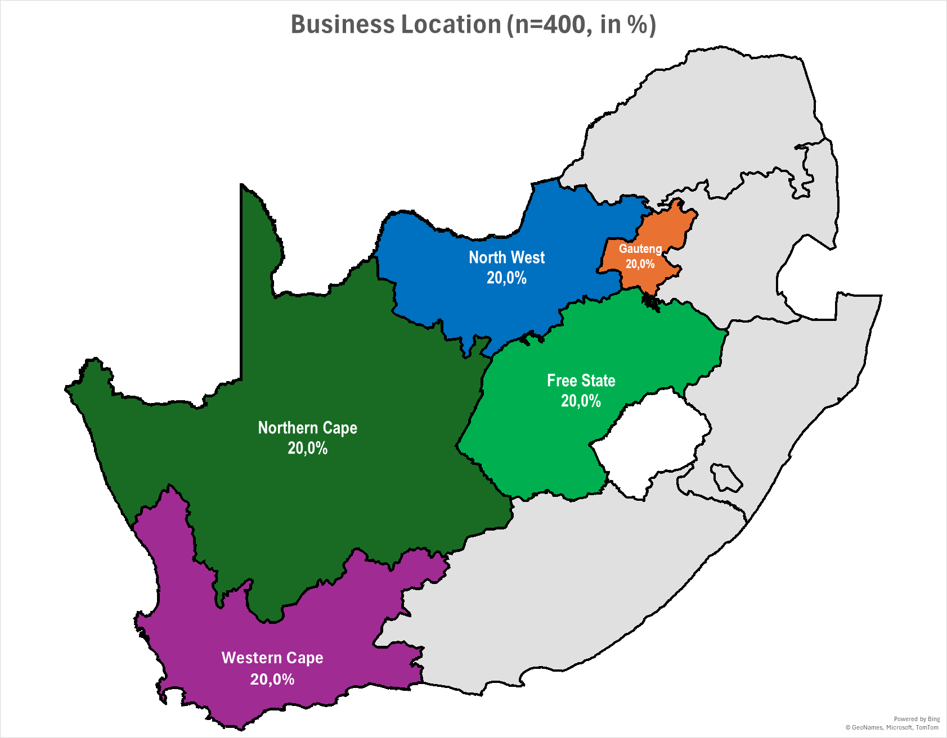
Quantitative results: Business locations and distribution across sectors
Equal representation of the 5 case study provinces, aligning with the methodological plan of having all the provinces under investigation equally represented, to avoid provincial bias due to overrepresentation and allow meaningful comparisons.
The equal representation of the tourism SMMEs balances comparability across provinces, resulting in findings that are a reflection of the actual tourism SMMEs landscape.
An analysis of the distribution of the tourism sectors among the tourism SMMEs participating in the study, mirroring the population ratio.
Notes:
The analysis of the findings was threefold – but for the sake of this presentation, only the overall and across-provinces findings will be presented due to time considerations.

Slide 12
SMME category
Due to the overall objective of the study, it was important to determine the tourism business’s SMME category.
Results revealed that most of the respondents’ businesses were micro enterprises (62%), followed by small enterprises (29%). The category of medium enterprises had the least number of respondents (9%).

Slide 13
Tourism SMMEs categories across provinces
The distribution of firm sizes differs across provinces
Across provinces, the Western Cape dominates in the micro-enterprises category (26,2%).
Free State dominates in the small and medium enterprises categories

Slide 14
Years in operation
The findings show an almost balanced distribution across the different categories of years in operation from 3 years or less (16%), 4-6 years (20.3%), 7-9 years (19%) and 10-15 years (17%).
However, most participants indicated that their businesses have been in operation for 10 years or more (44.7%), of which 27.7% indicated having been in operation for more than 15 years, thus recording the highest frequency.
These findings indicate a high percentage of SMMEs in the study are long-established businesses and are likely to have stable operations, whilst almost 6th of the businesses are young businesses (3 years and below, 16%), indicating emerging SMMEs, new entrants and start-ups

Slide 15
Distribution of tourism SMMEs in terms of years in operation across provinces
North West dominate in the emerging, new entrants and young businesses (6 years and below), Gauteng dominates the middle category of 7-9 years (27,7%).
The Northern Cape and Western Cape indicated having more mature businesses (more than 15 years)

Slide 16
SMMEs’ overall digital technologies experience
The results show that most tourism SMMEs have some digital technologies experience, although still learning and adapting (46%), and 42.5% are confident users, indicating that they are very experienced with using digital technologies.
Only a small percentage indicated limited or a lack of experience (11.5%).
These results suggest that the tourism industry, specifically the SMMEs, are digitally engaged, despite most of the businesses being in the transition phase.

Slide 17
Tourism SMMEs’ overall digital technologies experience across provinces
Comparing the distribution of tourism SMMEs’ overall digital technologies experience across provinces showed that most businesses in the Free State and Gauteng are very experienced and confident with using digital technologies, while WC (25%) dominates in the category of some experience and still learning.
The limited experience category is dominated by businesses in the NW (42,9%).

Slide 18
Sources of information regarding technology adoption in tourism
Notes: Only yes results are shown

Slide 19
Distribution of sources of information across provinces
The table indicates that, in terms of utilising industries and workshops as sources of information, the Western Cape leads with 21.9%.
The other provinces (Gauteng, Northern Cape, and North West) each contribute equally at 19.7%, while the Free State contributes 19%.
The use of online platforms is more dominant in Gauteng, with 22.2% and less common in North West, with 17.3%.
Gauteng dominates in the use of word of mouth (WOM) from other businesses with 21.5%, followed by Northern Cape (20.5%) and Western Cape (20.1%).
Regarding using government programs and initiatives as sources of information, Northern Cape (26.8%) and Gauteng (23.9%) dominate. Businesses in the Western Cape dominate in the category of using the private sector and technology providers (26.1%), as their sources of information regarding digital technology adoption,
 | Free State | Gauteng | Northern Cape | North West | Western Cape
Industry workshops/conferences | 19,0 | 19,7 | 19,7 | 19,7 | 21,9
Online platforms (e.g., social media, blogs) | 21,0 | 22,2 | 20,1 | 17,3 | 19,4
Word-of-mouth from other business owners | 19,8 | 21,5 | 20,5 | 18,1 | 20,1
Government programs and initiatives | 15,5 | 23,9 | 26,8 | 18,3 | 15,5
Private sector/technology providers | 12,1 | 21,7 | 22,9 | 17,2 | 26,1
Notes: Analysis based on affirmative responses only.

Slide 20
Digital tools and technologies implemented to improve business operations

Slide 21
Digital tools and technologies implemented across provinces
Social media was mostly implemented by businesses in the Free State, Gauteng and Western Cape, while websites had the highest popularity in Gauteng and Western Cape.
Digital payment systems were mostly implemented in Gauteng and the Northern Cape had the least implementation
Cloud-based file storage and collaboration tools and a website with an e-commerce platform were mostly implemented in the Western Cape.
The Northern Cape had the least implementation of mobile applications.
Free State indicated the highest implementation of data analytics and reporting tools and inventory management systems,
Virtual tour platforms and immersive technologies were mostly implemented in Gauteng followed by the Western Cape and were least implemented in the Northern Cape
 | Free State | Gauteng | Northern Cape | North West | Western Cape
Social media marketing tools | 21,8 | 20,9 | 18,5 | 18,2 | 20,6
Website | 19,7 | 22,1 | 17,0 | 20,0 | 21,2
Online booking | 21,9 | 19,9 | 17,2 | 20,3 | 20,7
Digital payment systems | 25,5 | 27,0 | 12,2 | 18,9 | 16,4
Cloud-based file storage and collaboration tools | 10,8 | 26,5 | 15,1 | 15,1 | 32,5
Mobile Apps | 20,3 | 21,7 | 14,0 | 23,6 | 20,4
Data analytics and reporting tools | 33,8 | 15,4 | 20,8 | 12,3 | 17,7
Website with an e-commerce platform | 19,5 | 15,0 | 8,0 | 9,7 | 47,8
Inventory Management Systems | 28,5 | 17,0 | 25,0 | 15,2 | 14,3
Virtual tour platforms and immersive technologies | 15,2 | 42,4 | 10,6 | 12,1 | 19,7

Slide 22
Business areas that benefited the most from technology adoption

Slide 23
Top five business areas that benefited the most from technology adoption across provinces
The results indicate that technology adoption has benefited tourism SMMEs in Gauteng and the Western Cape equally in the marketing area, with both regions seeing a 21.1% impact.
However, the effect of technology on sales was most significant in the Free State (22.8%), followed closely by Gauteng (22.5%).
In the customer service area, Gauteng led with a 22.6% benefit, while the Western Cape reported the greatest gains in communication and collaboration, with an impact of 24.9%.
 | Free State | Gauteng | Northern Cape | North West | Western Cape
Marketing | 20,8 | 21,1 | 18,4 | 18,7 | 21,1
Sales | 22,8 | 22,5 | 16,3 | 17,6 | 20,8
Customer service | 21,6 | 22,6 | 17,9 | 18,6 | 19,3
Operations | 25,1 | 22,9 | 14,5 | 18,1 | 19,4
Communication and collaboration | 21,4 | 17,4 | 19,4 | 16,9 | 24,9

Slide 24
Availability and adequacy of digital infrastructure
Overall, most businesses agreed that they have access to a reliable high-speed internet connection, reliable computer hardware, mobile devices such as smartphones and tablets for business operations, a secure and efficient payment system like online payment gateways and bank machines and such as Yoco machines (Mean score above 4 for all provinces).
Sufficient IT support to implement and maintain digital technologies was moderate to high for all provinces.
Having enough money to upgrade digital infrastructure and making use of government/ NGO funding and support programmes for digital infrastructure recorded low to moderate mean scores overall and for all provinces.
Greater availability and adequacy of digital infrastructure for each province are highlighted in green, and lower mean scores are in yellow
Availability and adequacy of digital infrastructure | Free State | Gauteng | Northern Cape | North West | Western Cape | Overall Mean
Access to a reliable high-speed internet connection | 4.31 | 4.56 | 4.09 | 4.19 | 4.54 | 4,34
Reliable computer hardware | 4.44 | 4.61 | 4.21 | 4.06 | 4.51 | 4,37
Mobile devices for business operations | 4.16 | 4.33 | 4.14 | 4.01 | 4.56 | 4,24
Secure and efficient payment system (e.g. online payment gateways, bank machines) | 4.48 | 4.66 | 4.16 | 4.49 | 4.51 | 4,46
Wi-Fi hotspots for customers. | 4.04 | 4.02 | 3.48 | 3.61 | 3.86 | 3,80
Cybersecurity measures | 4.09 | 3.91 | 3.80 | 3.18 | 4.06 | 3,81
Data backup systems. | 4.06 | 4.00 | 3.65 | 3.43 | 4.21 | 3,87
Sufficient IT support is available to implement and maintain digital technologies. | 3.94 | 3.70 | 3.26 | 3.29 | 3.88 | 3,61
Enough money to upgrade our digital infrastructure for my business’s digital transformation. | 3.34 | 3.40 | 2.58 | 3.31 | 3.54 | 3,23
Made use of government or NGO funding/support programmes for our digital infrastructure (e.g. NDT, SEFA, SEDA, DSBD, etc.). | 2.44 | 2.50 | 2.03 | 2.11 | 2.29 | 2,27

Slide 25
Benefits of digital technology adoption
Overall, there are many benefits to technology adoption for tourism SMMEs, as shown by the overall high mean scores ranging from 4.05 to 4.41, except for benefits related to improving the relationships with the company’s business partners and reducing costs to the company, which had mean scores of 3.78 and 3.48, respectively.
The overall low mean scores for benefits related to reducing costs to the company and improving the relationships with the company’s business partners indicate opportunities that are yet to be fully realised.
Greater benefits for each province are highlighted in green and lower benefits in yellow
Benefits of digital technology adoption | Free State | Gauteng | Northern Cape | North West | Western Cape | Overall Mean
Allowed me to reach and engage with a wider customer base. | 4.44 | 4.51 | 4.20 | 4.43 | 4.46 | 4.41
Increased the profits of my business. | 4.27 | 4.19 | 4.05 | 4.04 | 4.03 | 4.12
Increased time efficiency in customer service delivery. | 4.39 | 4.35 | 4.05 | 4.25 | 4.20 | 4.25
Improved customer satisfaction. | 4.34 | 4.26 | 4.14 | 3.90 | 4.20 | 4.17
Reduced costs to the company. | 3.78 | 3.40 | 3.30 | 3.15 | 3.78 | 3.48
Improved the relationships with the company’s business partners. | 3.99 | 3.85 | 3.56 | 3.72 | 3.78 | 3.78
Enabled my tourism business to remain sustainable and adaptable. | 4.27 | 4.02 | 4.00 | 3.95 | 3.99 | 4.05
Improved overall business performance. | 4.30 | 4.19 | 4.06 | 4.03 | 4.21 | 4.16
Made it easier to perform business tasks. | 4.30 | 4.25 | 4.04 | 4.24 | 4.17 | 4.20
Allowed me to have better control of the business. | 4.27 | 4.20 | 3.89 | 3.86 | 4.05 | 4.06

Slide 26
Challenges of digital technology adoption
Challenges of digital technology adoption | Free State | Gauteng | Northern Cape | North West | Western Cape | Overall Mean
Lack of financial resources needed to invest in digital technologies | 3.39 | 3.29 | 3.30 | 3.15 | 3.61 | 3,35
Resistance to change from employees or stakeholders | 2.93 | 2.60 | 2.90 | 2.89 | 2.93 | 2,85
Difficulty in choosing the right technology for the business's needs | 2.84 | 2.69 | 3.15 | 3.20 | 3.54 | 3,08
Lack of sufficient internet infrastructure or digital connectivity | 2.75 | 2.71 | 3.29 | 2.93 | 3.09 | 2,95
Integration challenges with existing business systems | 2.93 | 2.55 | 3.08 | 3.05 | 3.22 | 2,97
Time constraints in learning and adopting new technologies | 3.26 | 2.59 | 3.13 | 3.80 | 3.54 | 3,26
Privacy and security concerns regarding digital tools | 3.01 | 2.71 | 3.51 | 3.40 | 3.12 | 3,15
Limited access to reliable customer support for digital tools | 2.67 | 2.60 | 3.14 | 3.09 | 3.17 | 2,94
Lack of technical expertise or skills to use digital tools effectively | 2.70 | 2.68 | 3.25 | 3.18 | 3.45 | 3,05
Inadequate digital infrastructure in my region | 2.71 | 2.50 | 3.46 | 3.03 | 2.69 | 2,88
Lack of training services to help use digital technologies | 2.75 | 2.89 | 3.73 | 3.65 | 3.25 | 3,25
High costs of data and training services for digital technologies | 3.25 | 3.14 | 3.53 | 3.80 | 3.65 | 3,47
Lack of government funding or incentives to support the digital transformation of tourism SMMEs | 3.24 | 3.83 | 3.81 | 3.74 | 3.97 | 3,72
Getting finance from the bank (loan) to pay for digital infrastructure and equipment. | 3.01 | 3.31 | 3.41 | 3.54 | 3.39 | 3,33
The study revealed a clear contrast between financial and non-financial challenges.
Overally, financial challenges dominate, with most businesses facing challenges related to government funding or incentives to support the digital transformation of tourism SMMEs, high costs of data and training services for digital technologies, and limited financial resources.
Non-financial challenges strongly noted include time constraints in learning and adopting new technologies, lack of training services to help use digital technologies and lack of technical expertise or skills to use digital tools effectively.
Main challenges for each province are highlighted in red and the least are in yellow

Slide 27
Innovative opportunities for tourism SMMEs
Overall, most businesses highly rated digital marketing and viewed it as essential for business growth, followed by data analytics for business decision-making.
Mobile applications were also rated high and viewed as fundamental in improving customer engagement and streamlining booking.
Integrating AI for customer service and integrating Augmented Reality (AR) or Virtual Reality (VR) for immersive experiences were moderately supported, showing the growing awareness of their operational and experiential value in tourism.
Blockchain, though significantly rated, opinions were more mixed than other opportunities.
Higher innovative opportunities for each province are highlighted in green and lower ones in yellow
Innovation opportunities | Free State | Gauteng | Northern Cape | North West | Western Cape | Overall Mean
Integrating artificial intelligence (AI) for customer service (e.g. chatbots, virtual assistants) enhances business operations | 3.70 | 4.06 | 3.71 | 3.23 | 3.52 | 3,65
Using data analytics for business decision-making would improve my ability to understand customer preferences and trends | 4.01 | 4.31 | 4.24 | 4.17 | 3.87 | 4,12
Integrating Augmented Reality (AR) or Virtual Reality (VR) into my services would create a more immersive experience for my customers | 3.72 | 4.01 | 3.94 | 3.39 | 3.44 | 3,7
Developing a mobile app for my business would improve customer engagement and streamline bookings | 4.27 | 4.10 | 4.05 | 4.20 | 3.52 | 4,03
Implementing digital marketing strategies (e.g. social media, email marketing, Search engine optimisation (SEO) is essential for my business’s growth | 4.47 | 4.50 | 4.41 | 3.97 | 4.30 | 4,33
Blockchain technology could improve the security and transparency of transactions in my business | 4.05 | 4.07 | 3.85 | 3.65 | 3.34 | 3,79

Slide 28
Further analyses
The researchers analysed the influence of digital technology infrastructure, perceived benefits, challenges, innovation opportunities for tourism SMMEs’ growth and sustainability across the five provinces using correlation analyses.
Free State perspectives: Digital technology infrastructure, perceived benefits, challenges and innovation opportunities
Notes: **Correlation is significant at the 0.01 level, 2-tailed, Strength of co-relationship [Cohen, 1988] - Small = 0.10, Medium= 0.30, and Strong = 0.50
Strong, positive and significant correlation between perceived benefits and digital technology infrastructure (r=0.647, p<0.01), indicates that in the Free State province, tourism SMMEs perceiving better digital technology infrastructure also tend to report higher perceived benefits of technology adoption.
The strong, significant negative correlation between perceived challenges and digital technology infrastructure (r=0.568, p<0.01), suggests that as digital infrastructure improves, the perceived challenges associated with technology adoption reduce.
FREE STATE | DTI | BEN | CHA | INN
Digital technology infrastructure (DTI) | 1
Perceived benefits (BEN) | 0.647** | 1
Perceived challenges (CHA) | -0.568** | -0.541** | 1
Innovation ((INN) | -0.076 | 0.045 | 0.292** | 1

Slide 29
Further analyses cont..
Gauteng perspectives: Digital technology infrastructure, perceived benefits, challenges and innovation opportunities
Notes: **Correlation is significant at the 0.01 level, 2-tailed, Strength of co-relationship [Cohen, 1988] - Small = 0.10, Medium= 0.30, and Strong = 0.50
Similarly for Gauteng, results showed a strong, positive and significant correlation between DTI and BEN (r=0.501, p<0.01), a negative, moderate correlation between DTI and CHA (r=-0.405, p<0.01) and a significant negative correlation between BEN and CHA (r=-0,419, p<0.01).
Unlike Free State, a small to medium, positive correlation between DTI and INN (r=0.272, p<0.01) as well as BEN and INN (r=0,323, p<0.01), was noted, suggesting that for Gauteng tourism SMMEs, infrastructural improvements and perceived benefits translate to innovative practices and behaviour.
GAUTENG | DTI | BEN | CHA | INN
Digital technology infrastructure (DTI) | 1
Perceived benefits (BEN) | 0.501** | 1
Perceived challenges (CHA) | -0.405** | -0.419** | 1
Innovation ((INN) | 0,272* | 0,323** | -0,042 | 1

Slide 30
Further analyses cont..
Northern Cape perspectives: Digital technology infrastructure, perceived benefits, challenges and innovation opportunities
Notes: **Correlation is significant at the 0.01 level, 2-tailed, Strength of co-relationship [Cohen, 1988] - Small = 0.10, Medium= 0.30, and Strong = 0.50
For Northern Cape, a medium to strong, positive and significant correlation between DTI and BEN (r=0.456, p<0.01) and a negative, small to medium correlation between DTI and CHA (r=-0.296, p<0.01), similar to Free State and Gauteng, though slightly weaker due to unequal digital access in the province.
Correlation between perceived benefits and challenges is almost zero, indicating no significant relationship and possibly revealing the dual reality where opportunities and constraints exist.
A positive and significant correlation between CHA and INN (r=0.454, p<0.01), reveals that tourism SMMEs facing challenges are likely to pursue innovative solutions to adapt, indicating the adaptive behaviour of peripheral tourism economies.
NORTHERN CAPE | DTI | BEN | CHA | INN
Digital technology infrastructure (DTI) | 1
Perceived benefits (BEN) | 0.456** | 1
Perceived challenges (CHA) | -0.296** | 0,004 | 1
Innovation ((INN) | 0,066 | 0,159 | 0,454** | 1

Slide 31
Further analyses cont..
North West perspectives: Digital technology infrastructure, perceived benefits, challenges and innovation opportunities
Notes: **Correlation is significant at the 0.01 level, 2-tailed, Strength of co-relationship [Cohen, 1988] - Small = 0.10, Medium= 0.30, and Strong = 0.50
For North West, a strong, positive and significant correlation between DTI and BEN (r=0.520, p<0.01), emphasises the role of digital technology infrastructure in shaping positive benefit perceptions.
Non-significant correlation between DTI and CHA (r=-0.037), suggesting that in North West, infrastructural improvements alone do not necessarily alleviate the province’s challenges pointed out earlier, such as high costs of data and training services for digital technologies.
NORTH WEST | DTI | BEN | CHA | INN
Digital technology infrastructure (DTI) | 1
Perceived benefits (BEN) | 0.520** | 1
Perceived challenges (CHA) | -0.037 | -0,055 | 1
Innovation ((INN) | 0,447** | 0,355** | 0,310** | 1

Slide 32
Further analyses cont..
Western Cape perspectives: Digital technology infrastructure, perceived benefits, challenges and innovation opportunities
Notes: **Correlation is significant at the 0.01 level, 2-tailed, Strength of co-relationship [Cohen, 1988] - Small = 0.10, Medium= 0.30, and Strong = 0.50
For the Western Cape, a medium to strong, positive and significant correlation was noted between DTI and BEN (r=0.461, p<0.01), suggesting that with good infrastructure, such as a reliable internet connection, tourism SMMEs tend to recognise higher benefits associated with technology adoption.
Innovation construct demonstrated a significant positive association with DTI, BEN and CHA, emphasising its central role in the digital technology adoption process.
As DTI improves, tourism SMMES are capable of adopting innovative practices, perceived benefits stimulate innovative behaviour and even if tourism SMMES in the Western Cape face challenges, they are resilience-driven, they look for creative solutions such as utilising alternative platforms
WESTERN CAPE | DTI | BEN | CHA | INN
Digital technology infrastructure (DTI) | 1
Perceived benefits (BEN) | 0.461** | 1
Perceived challenges (CHA) | 0,048 | -0,019 | 1
Innovation ((INN) | 0,296** | 0,441**** | 0,284** | 1

Slide 33
Some Preliminary Recommendations

Slide 34
Recommendations from tourism SMMEs for digital adoption
Recommendations | Free State | Gauteng | Northern Cape | North West | Western Cape | Overall Mean
Government incentives (e.g., tax breaks, funding) would encourage my business to adopt digital technologies | 4.09 | 4.29 | 4.41 | 3.84 | 4.09 | 4,14
Access to affordable digital tools and platforms would make it easier for my business to integrate technology | 4.24 | 4.54 | 4.51 | 4.33 | 4.21 | 4,37
Free/subsidised digital skills training and upskilling programs are essential for my business to successfully adopt new technologies | 4.15 | 4.48 | 4.56 | 4.11 | 4.13 | 4,29
Collaborating and partnering with digital service providers (e.g., software companies, internet providers) would help my business implement new technologies more effectively | 4.26 | 4.46 | 4.43 | 4.06 | 4.14 | 4,27
Peer networks and mentorship programs could help my business better understand and use digital technologies | 4.01 | 4.31 | 4.51 | 3.93 | 3.95 | 4,14
Supportive regulatory environment could help to facilitate digital transformation in my business. | 4.03 | 4.26 | 4.25 | 3.89 | 3.93 | 4,07
Better digital infrastructure (e.g., improved internet access, cybersecurity) would enhance my business’s ability to adopt technology | 4.20 | 4.34 | 4.54 | 4.16 | 4.03 | 4,25
Public-private partnerships could help small businesses like mine overcome barriers to digital transformation | 4.04 | 4.10 | 4.24 | 3.95 | 3.70 | 4,01
Financial support such as grants, subsidies and low-interest loans can help me adopt digital technologies in my business. | 4.06 | 4.20 | 4.62 | 3.85 | 3.89 | 4,13
Overall, recommendations for enabling conditions for technology adoption among tourism SMMEs received high mean scores.
Highly recommended factors were access to affordable digital tools and platforms, digital skills training and upskilling programs, collaboration and partnering with service providers and better digital infrastructure, indicating the importance of affordability, capacity building and reliable infrastructure.
The results also revealed the demand for policy and financial support, as evidenced by respondents’ ratings for government incentives, peer networks and mentorship and financial support mechanisms.
Highly recommended strategies for each province are highlighted in green and lower ones in yellow

Slide 35
Context-specific recommendations for policy and practice
Province | Stakeholder | Recommendation
Free State | Provincial government and municipalities | Introduce innovative support funds for tourism SMMEs
 | Tourism and business associations | Facilitate mentorship, peer-learning and networks for digital adoption
 | Tourism SMME owners | Move toward innovative digital service delivery such as using AI, VR and immersive storytelling.
Gauteng | Government | Position Gauteng as South Africa’s Smart-Tourism Innovation Hub
 | Academics and institutions | Industry partnerships for smart tourism pilots (co-develop and partner in research)
 | Tourism SMME owners | Invest in data analytics, omnichannel marketing, immersive experience design
Northern Cape | Municipalities, SEDA | Establish rural innovation incubators and strengthen internet connectivity in remote areas
North West | Universities and TVET colleges | Provide short courses on digital innovation and resilience
 | Governments and industry associations | Establish innovation hubs. Organise provincial digital innovation challenges
Western Cape | Government | Promote the adoption of advanced digital tools (AI, AR/VR, blockchain) through tax incentives.

Slide 36
Recommendations
In addition to increasing the availability of funding for tourism SMMEs, greater efforts should be made to reduce bureaucratic barriers that hinder access to these funds.
Strengthened collaboration among key stakeholders is essential to support SMMEs’ digital adoption and to ensure the efficient and effective implementation of related policies. For instance, partnerships between higher education institutions and government departments could facilitate the placement of unemployed graduates to assist SMMEs in adopting digital technologies.
Considering the contradiction between high demand for government support, perceived lack of support and low usage of available programmes, awareness of existing government programmes aimed at supporting SMMEs and fostering digital innovation should be enhanced through both formal and informal communication networks. These may include trade associations, as well as SMME-focused communication platforms such as WhatsApp and Facebook community groups.
The most developed provinces in terms of digital infrastructure should advance toward the delivery of immersive digital experiences. Conversely, resource-constrained provinces should prioritise low-cost technologies and innovations that promote sustainability and resilience, such as the adoption of greener energy solutions.
Academic institutions should also play a key role by offering digital literacy short courses and training programmes, supported by funding from relevant government departments.
Furthermore, establishing a formal professional body for tourism SMMEs could facilitate information sharing, advocate for fair representation, and promote equitable access to opportunities across all tourism subsectors and provinces.

Slide 37
The end

