Slide 1
Exploring the Digital Technology Adoption Landscape of Niche Tourism Small, Medium and Micro Enterprises in South Africa
Dr PPS Sifolo, Dr LC Welthagen, Dr R Naudé-Potgieter, Mr M Londani
Centre for Sustainable Tourism & Innovation
24 October 2025
Notes:
SMMEs create more than 60% of the jobs in South Africa (Ramukumba, 2023).
We are trailing far behind the world. Statistics in Europe suggest that more than 75% of jobs are created by the small business community (Bargraim, 2024).
Now more than ever, SMMEs need to be able to develop, adopt and implement a digital transformation strategy (DT strategy) since they are pivotal to South Africa’s tourism industry, particularly in niche sectors such as events, adventure and ecotourism, cultural and rural tourism and wildlife tourism (Bolland, 2017).
Tourism SMMEs, despite their potential, face challenges in digital technology adoption in order to stay abreast of the continuous digital revolution, which impacts their development, growth, and sustainability.
Digital technology adoption in these sectors can enhance operational efficiency, marketing reach, customer engagement, and overall business performance. However, many SMMEs struggle with technology integration due to limited resources and skills.
To gain a comprehensive understanding of the digital technology adoption patterns and challenges faced by niche to tourism SMMEs in South Africa, and to identify potential innovation opportunities to enhance their development, growth, and sustainability.

Slide 2
Introduction & Background
Digital technology (DT) in the tourism industry is proactively using AI-based technology to transform the industry by improving operational efficiency, customer experience and engagement (Avula & Sithole, 2025).
Limited understanding of the benefits associated with digital technology adoption among niche tourism SMMEs may constrain their capacity to optimise operational efficiency and competitiveness (Mosweunyane, 2016).
Literature reveals that SMMEs often lack the necessary financial resources, technical expertise, and human capital to invest in and effectively utilise digital tools (Botha, Smulders, Combrink & Meiring, 2021).
A significant portion of SMMEs may have limited digital literacy, hindering their ability to adopt and utilise digital technologies effectively.
Infrastructure constraints such as inadequate internet connectivity and digital infrastructure in certain regions can pose barriers to digital technology adoption (Akpan et al. (2020).
SMMEs may require specific support and guidance to navigate the complexities of digital technology adoption and overcome challenges. There is a lack of tailored support and guidance.
Notes:
Technologies such as online booking systems, social media marketing and data analytics are critical for the competitiveness of tourism enterprises (Buhalis & Moldavska (2022).
The role of technology in the sphere of gambling in casinos are undeniable, with an explosion of online casinos globally, mobile gaming gaining popularity and blockchain technology facilitating the usage of cryptocurrencies such as bitcoin and Ethereum (Global Brands, 2024).
Anyone can now gamble anytime from the comfort of their homes, against international participants from across the world. Taxes and levies generated by the gambling sector amounted to R4.0 billion in 2022 (National Gambling Board, 2023).

Slide 3
Niche tourism SMMES in South Africa
Events and Limited Pay-out Machines (LPM)
Wildlife Tourism
Supports conservation efforts and generates revenue through wildlife-related activities
In 2023, the average wildlife tourist spent R31,200 per person, nearly three times the average tourist expenditure in South Africa (R11,800) (South African Tourism, 2024). There is room for SMMEs to play a role.
South Africa's gambling revenue was reported as ZAR75 billion ($4.3 billion) for the financial year 2024-25 (National Gambling Board, 2025)
Adventure and Ecotourism
These niches are crucial for promoting South Africa’s natural and cultural assets while contributing to environmental sustainability.
Cultural, Township and Rural Tourism
This sector fosters local community development and preserves cultural heritage
Event Management Industry in South Africa contributed R74.9bn to the national economy
Promoting geographic diversity in tourism the District Development Model by advancing equitable tourism growth across South Africa’s districts and metropolitan areas.
Ecotourism in South Africa offers a rare combination of adventure, luxury, and sustainability.
Generate significant revenue, making major tax contributions,
Stimulate the economy
Create multitudes of employment opportunities
Notes:
Taking place in Makapanstaad – domestic tourism
Trooper celebration
Diturupa Carnival
South Africans spent R1.5 trillion on gambling activities during the 2024/25 financial year,

Slide 4
Research Objectives
Describe the niche tourism SMME digital technology adoption landscape in South Africa.
Examine potential benefits and challenges related to digital technology adoption by niche tourism SMMEs.
Determine digital technologies and applications that may be leveraged to enhance niche SMME business processes for them to thrive.
Determine the digital technology infrastructure requirements that may enable the development, growth and sustainability of niche tourism SMMEs.
Assess and outline clear innovation opportunities and potential partnerships to be fostered for niche tourism SMME growth and sustainability.
Provide practical recommendations on enablers of digital technology adoption for SMME sustainability.

Slide 5
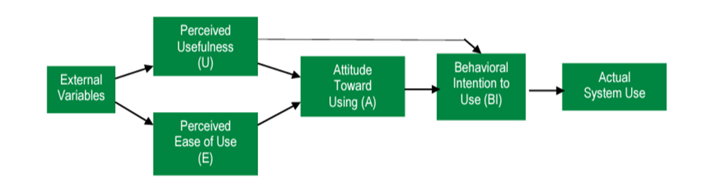
Conceptual Framework for Digital Technology Adoption in Tourism SMMEs
Impact on Digital Adoption Landscape
Technological Determinism
Innovation Opportunities for Growth and Sustainability
Broader outcomes for niche tourism SMME- Growth & Market Expansion, Increased Competitiveness& Sustainable Practices
Figure 1: Technology Acceptance Model (TAM).
Source: Davis (1989)
Figure 2: Technological Determinism in Digital Technology Adoption of Niche Tourism SMMEs
Source: Developed for this study
Notes:
A popular approach in the travel and hospitality sector backs up Davis's (1989) Technology Acceptance approach (TAM). Moreover, TAM, as displayed in Figure 1, promotes the notion that people will be more receptive to adopting a technology if they believe it to be simple to use (Davis 1989).
The Technology Acceptance Model (TAM) is a theory that explains how to encourage users to adopt new technology. The model's purpose is to predict how likely a group or organization is to adopt a new technology.
TAM is based on the idea that a user's beliefs, attitudes, and intentions determine their likelihood of adopting a new technology. The model's two main factors that influence a user's acceptance are:
Perceived usefulness
How much a user believes the technology will help them perform better or achieve their goals
Perceived ease of use
How much a user believes the technology will be easy and straightforward to use
The TAM was developed by Fred Davis in 1986. It's based on the psychological theories of reasoned action and theory of planned behavior.
Technological Determinism" :"Technology drives societal changes, influencing behaviors, practices, and growth opportunities in niche tourism SMMEs.
"First Layer (Impact on Digital Adoption Landscape)Around the core, place three interconnected bubbles: Digital Infrastructure Influences access and adoption readiness. Technological Capabilities of SMMEs Defines capacity for technology integration. Market Dynamics and Consumer Expectations Shapes demand for innovative solutions.
Second Layer (Innovation Opportunities for Growth and Sustainability)Expand further outward with key opportunities: Enhanced Customer Engagement Utilizing AI and social media for personalized experiences. Efficient Supply Chain Management Adoption of blockchain and IoT for transparency. Digital Marketing Innovations Leveraging SEO, AR/VR, and targeted campaigns. Sustainability and Green Tech Integration Focused on eco-friendly solutions and digital tracking.
Outcomes (Outer Layer)Connect these themes to broader outcomes for niche tourism SMMEs: Growth and Market Expansion Increased Competitiveness Sustainable Practices

Slide 6
Research Methodology
The integration of real-time consumer intelligence, dynamic big data mining, artificial intelligence, and contextualisation can transform service co-creation by mobilising resources in the ecosystem (Buhalis & Sinarta, 2019).
Mixed-methods approach
Quantitative Surveys: Online surveys
Qualitative Interviews: In-depth interviews
Concurrent Mixed Method Approach
NDT Database (4324)
812 classified as niche SMMEs
Google Forms,
Surveys (127)
Digital ecosystem analysis (685)
Microsoft Teams, WhatsApp
Gambling sites (LPMs) - 36
Event SMMEs - 29
Notes:
The digital tools assisted in checking the following;
Whether the business has a functioning website
Is listed on booking platforms
Active on social media or uses other digital channels
It also identified challenges
Feedback and insights were drawn from digital behaviour, as well as information provided through direct responses available online, such as videos. This approach allowed us to map any SMME’s digital footprint in real time. Personal data could not be captured in this section, but it was captured in the survey section, where respondents captured direct responses. Details such as business location, online activity and digital presence were confirmed through automated searches, online records and publicly available information. By combining real-time data collection with a structured framework, this methodology provides a full picture of digital maturity, gaps and readiness across the selected tourism SMMEs directly aligned with the structure and purpose of the questionnaire. Other public systems for demographic, age, and company details were from the Companies and Intellectual Property Commission (CIPC) website, the Central Supplier Database (CSD) and Bizportal, all of which provide publicly available information. The following section presents the data analysis

Slide 7
QUANTITATIVE RESULTS
Digital Technology in South Africa’s Niche Tourism: Survey vs Ecosystem Insights

Slide 8
SURVEY DEMOGRAPHICS CHARECTERISTICS
Variable | Description | Percentage %
Owner/Manager/Employee | Owner | 67.7
 | Manager | 15.0
 | Employee | 17.3
Age Group | 18 – 25 | 9.4
 | 26 – 35 | 16.5
 | 36 – 45 | 28.3
 | 46 – 55 | 19.7
 | 56 and Above | 26.0
Highest level of Education | Less than Grade 12 | 3.9
 | Grade 12/Matric NQF4 | 30.7
 | N6 Certificate/NQF5 | 5.5
 | National Diploma/Diploma | 24.4
Bachelor’s Degree/BTech NQF7/Advanced Diploma 24.4
 | Honours Degree/PGD/NQF8 | 3.9
 | Master’s Degree/NQF9 | 7.1
Size of Business | 1 - 5 Employees (Micro) | 56.7
 | 6 - 20 Employees (Very Small) | 25.2
 | 21 - 50 Employees (Small) | 11.0
 | 51 - 200 (Medium) | 7.1

Slide 9
Province | Gauteng | 19.7
 | Limpopo | 25.2
 | North West | 3.9
 | Mpumalanga | 5.5
 | Free State | 3.9
 | KwaZulu-Natal | 14.2
 | Northern Cape | 1.6
 | Western Cape | 17.3
 | Eastern Cape | 8.7
Primary Niche Tourism | Adventure/outdoor/hostelling/caravan/camping/ Backpacker | 21.3
 | Ecotourism/wildlife/nature tourism/ Nature /game lodge | 20.5
 | Township and rural tourism SMMEs/ country house | 20.5
 | Historical tours and indigenous cultural/traditional experience/tour operators and guides | 34.6
Years of Operating | Less than a year | 5.5
 | 2̶ 3 years | 17.3
 | 4–5 years | 11.0
 | 6–10 years | 22.0
 | 11–15 years | 18.9
 | 16–20 years | 11.0
 | 21 years and more | 14.2

Slide 10
DIGITAL ECOSYSTEM ANALYSIS DEMOGRAPHIC CHARECTERISTICS
Variable Description Percentage %
Owner/Manager/Employee Owner 35.9
Manager 30.2
Employee 33.9
Age Group 18 – 25 1.6
26 – 35 22.5
36 – 45 23.4
46 – 55 29.2
56 and Above 23.4
Highest level of Education Less than Grade 12 0.6
Grade 12/Matric NQF4 23.8
N6 Certificate/NQF5 0.9
National Diploma/Diploma 27.6
Bachelor’s Degree/BTech NQF7/Advanced Diploma 22.3
Honours Degree/PGD/NQF8 22.8
Master’s Degree/NQF9 1.3
Doctoral Degree/NQF10 0.7
Size of Business 1-5 Employees (Micro) 47.2
6-20 Employees (Very Small) 47.9
21-50 Employees (Small) 2.3
51-200 (Medium) 2.6

Slide 11
Province Gauteng 8.0
Limpopo 17.7
North West 5.0 Mpumalanga 11.5
Free State 3.5
KwaZulu-Natal 9.9
Northern Cape 3.4
Western Cape 28.3
Eastern Cape 12.7
Primary Niche Tourism Adventure/Outdoor/Hostelling/Caravan/Camping/Backpacker 2.7
Ecotourism/Wildlife/Nature Tourism SMMEs/ Nature /Game Lodge20.2
Township & Rural Tourism SMMEs/Country house 25.0
Historical Tours & Indigenous Cultural/
Traditional experience/Tour operators & Guides 52.2
Years of Operating Less than a year 0.7
2 -3 years 18.7
4 – 5 years 17.7
6 – 10 years 20.4
11 – 15 years 20.4
16 – 20 years 1.6
21 years & more 20.4

Slide 12
Sector or company specific digital technologies used currently used in niche SMMEs: Comparison between survey and digital ecosystem
Notes:
Distribution and Booking platforms (Online Travel Agencies OTAs) - Platforms like Expedia, Booking.com, andAirbnb; Global Distribution Systems (GDS): Platforms like Amadeus and Sabre, or real-time inventory management
Secure Transactions & Digital Payments Blockchain for Secure Transactions for security in payments, loyalty programs, & contracts; Contactless Mobile Technologies such as Mobile Payments & Digital Wallets enables eamless transactions via Apple Pay, Google Pay, and QR codes; Mobile Check-ins & Digital Keys
AI-powered support Chatbots & Virtual Assistants eg; Expedia’s chatbot, hotel concierge bots); Internet ofThings (IoT) & Smart Hospitality that automates customer support; Predictive Analytics or Customer Insights;Smart Destinations & Digital Mapping eg AI-powered Travel Itineraries: Google Maps, TripIt, and AI-drivenplanners optimize travel routes; Sustainable & Green Tech Innovations such as Smart Energy Management. AI isused to optimize energy use and reduce waste. / Eco-friendly Travel Apps and Big Data Analytics
SMART infrastructure such as keyless room access, smart lighting, and energy-efficient operations; PersonalizedRoom Settings including those that adjusts temperature, lighting, and entertainment based on guestpreferences; Smart sensors track foot traffic and environmental impact.
Digital graphic technologies Augmented Reality (AR) for Navigation & Tourism Experiences; Virtual Reality (VR)for Tours Other

Slide 13
Differences in how digital technology is adopted by Provinces (%)
Survey respondents’ dataset (D): Data technology effectiveness
Digital ecosystem analysis (D): Data technology effectiveness

Slide 14
Differences in how digital technology is adopted by primary niche tourism SMMEs (%)
Survey respondents’ dataset (E): Data technology effectiveness
Digital ecosystem analysis (E): Data technology effectiveness

Slide 15
Primary drivers of digital technology engagement and related business practices

Slide 16
Primary drivers of digital technology engagement and related business practices by Provinces (%)
Survey respondents’ dataset (F): Data technology effectiveness
Digital ecosystem analysis (F): Data technology effectiveness

Slide 17
Primary drivers of digital technology engagement and related business practices by primary niche tourism SMMEs (%)
Survey respondents’ dataset (G): Data technology effectiveness
Digital ecosystem analysis (G): Data technology effectiveness

Slide 18
Barriers to digital adoption among niche tourism SMMEs in South Africa

Slide 19
Barriers to digital adoption among niche tourism SMMEs in South Africa by Provinces (%)
Survey respondents’ dataset (H): Data technology effectiveness
Digital ecosystem analysis (H): Data technology effectiveness

Slide 20
Barriers to digital adoption among niche tourism SMMEs in South Africa by primary niche tourism SMMEs (%)
Survey respondents’ dataset (I): Data technology effectiveness
Digital ecosystem analysis (I): Data technology effectiveness

Slide 21
The adoption of innovative tourism practices across adventure and ecotourism, wildlife, township, rural tourism and cultural experiences in South Africa

Slide 22
The adoption of innovative tourism practices across adventure and ecotourism, wildlife, township, rural tourism and cultural experiences in South Africa by provinces (%)
Survey respondents’ dataset (J): Data technology effectiveness
Digital ecosystem analysis (J): Data technology effectiveness

Slide 23
The adoption of innovative tourism practices across adventure and ecotourism, wildlife, township, rural tourism and cultural experiences in South Africa by primary niche sector (%)
Survey respondents’ dataset (K): Data technology effectiveness
Digital ecosystem analysis (K): Data technology effectiveness

Slide 24
To what extent do the following internal factors influence your decision to adopt digital technologies?
Survey respondence dataset (A): internal factors influencing digital technology adoption
Digital ecosystem analysis (A): internal factors influencing digital technology adoption

Slide 25
    To what extent do the following external factors influence your decision to adopt digital technologies?
Survey respondents’ dataset (B): External factors influencing the decision to adopt digital technologies
Digital ecosystem analysis (B): External factors influencing the decision to adopt digital technologies

Slide 26
Effectiveness of digital technology adoption
Survey respondents’ dataset (C): Data technology effectiveness
Digital ecosystem analysis (C): Data technology effectiveness

Slide 27
QUALITATIVE RESULTS
Digital Technology in South Africa’s Niche Tourism: Events and Limited Payout Machines

Slide 28
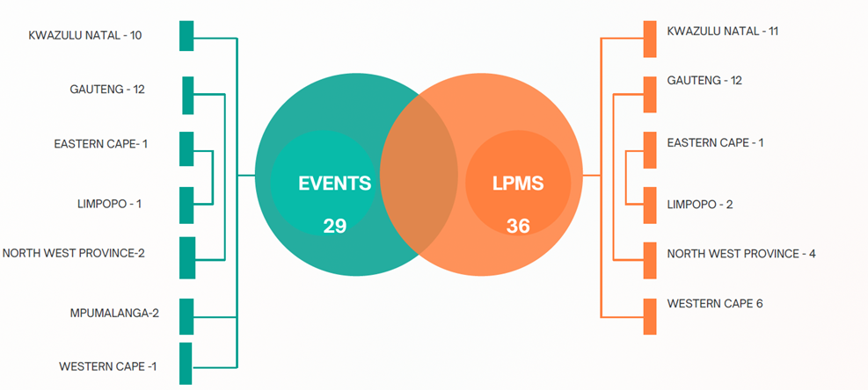
Purposive Intensity Sampling

Slide 29
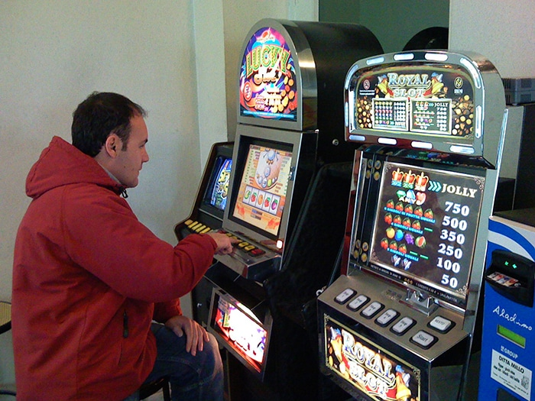
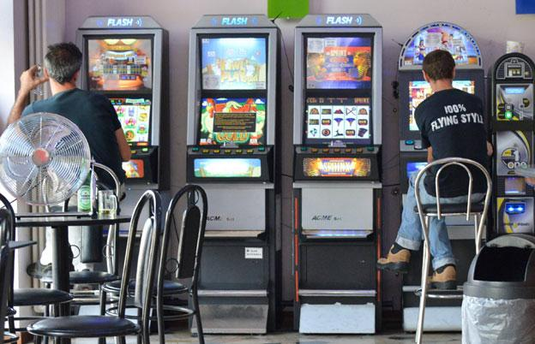
LPM niche SMME’s

Slide 30
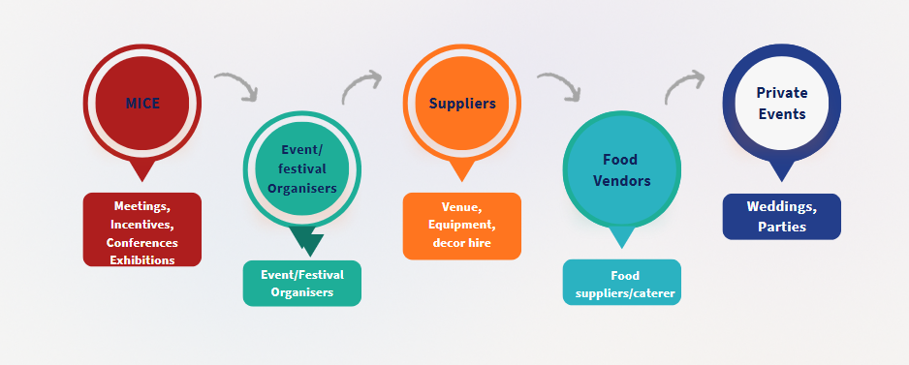
Events niche SMME’s

Slide 31
Type of business operation | Yearsof Business Operation | No. of Employees
All events | 3 Years | Not Specified
All events | 13 Years | 8 Permanent
Mobile and virtual events | 10 Years | 20 Employees
Marketing and consulting | 1 Year | 1 Employee
Handling of business events- conferences | 6 Years | 50 - 60 Employees
Trading | 13 Years | 8 Employees
Exclusive, venue and event operations | 7 Years | Not Specified
Marketing, event and safety planning | 5 Years | 3 Employees
Corporate and private events | 3 Years | 2- 5 Employees
Meeting, Incentive, Conferences and Events (MICE) | 3 Years | 2 Part-Time Employees
Event, PCO services, Health and Safety and Risk Assessment | 15 Years | 4 Permanent and 320 Part Time
Cultural Tourism focusing on Music and Arts | 5 and 4 Years | 10 Permanent and 20 Part Time
Culinary convenience company | 7 Years | 4 Permanent and 8 Part Time
Catering company | 8 Years | 2-3 Employees
Events and Equipment Hire | 7 Years | Not Specified
All events | 20 Years | 2 Employees
Decor and Catering | 4 Years | 4 Employees
Event Management amd PCO Services | 15 Years | 4 Permanent and 320 Part Time
Festival organizers (afrobeats) | 10 Years | 10 Permanent
Tradition food vendor | 2 Years | Not Specified
Mobile kitchen fast food | 2 Years | 5 Employees
Kitchen and Takeaways | 4 Months | 2 Employees
Fast food | Not Mentioned | 2 Employees
Fast food | 6 Months | 4 Employees
Attraction management (fast paced rides) | 19 Years | 9 Employees
Braai catering | 2 Years | 4 Employees

Slide 32
LPM Demographics

Slide 33
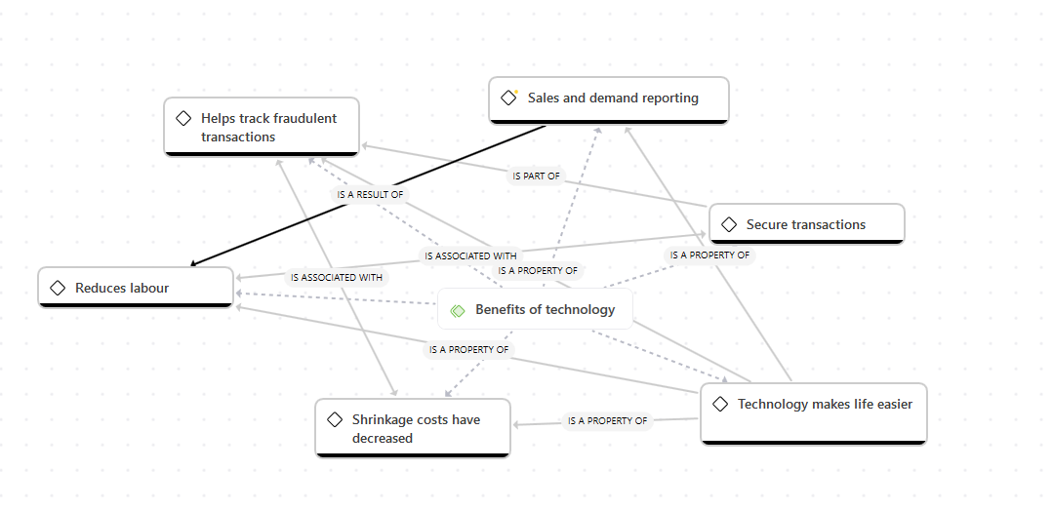
Benefits of digital technology adoption within the Limited payout machines and events niche area in South Africa

Slide 34
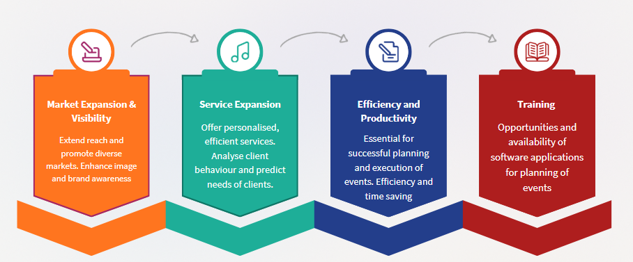
Benefits of digital technology adoption within the events niche area in South Africa

Slide 35
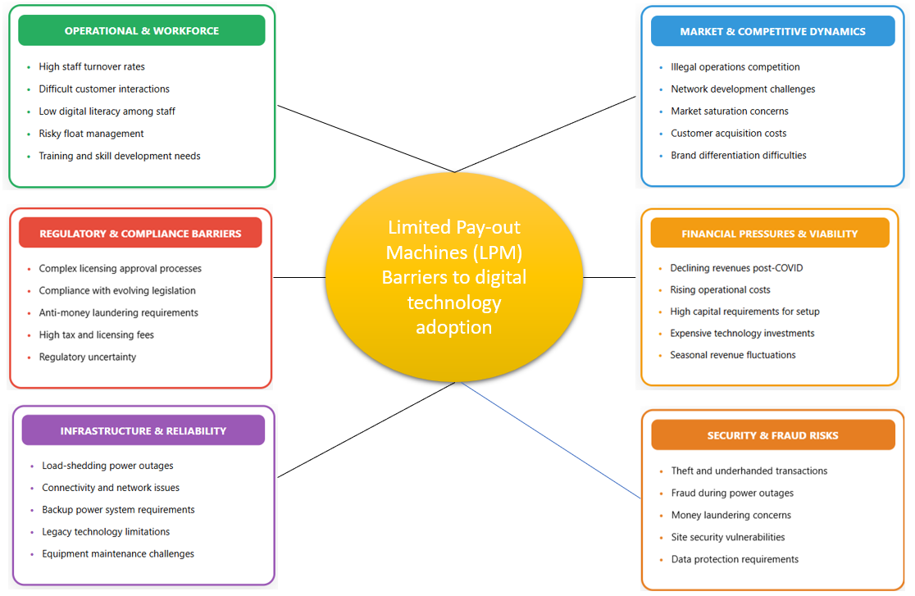

Slide 36
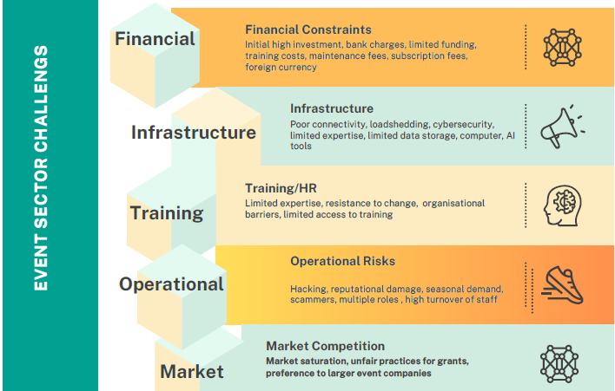

Slide 37
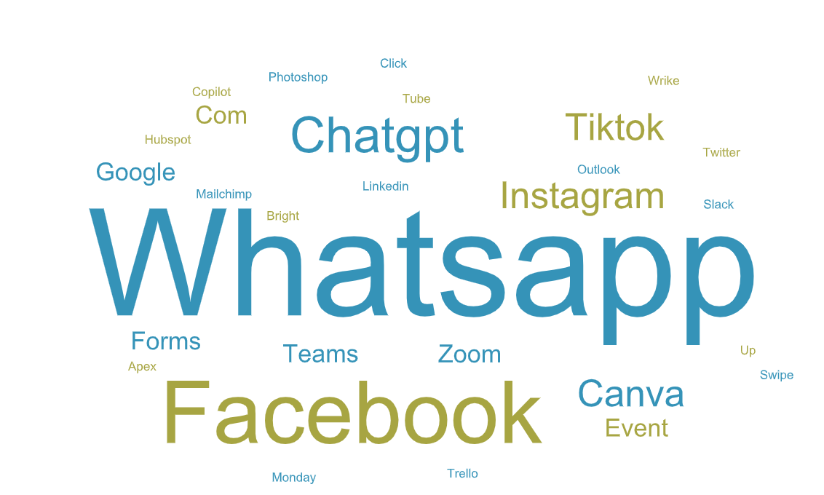
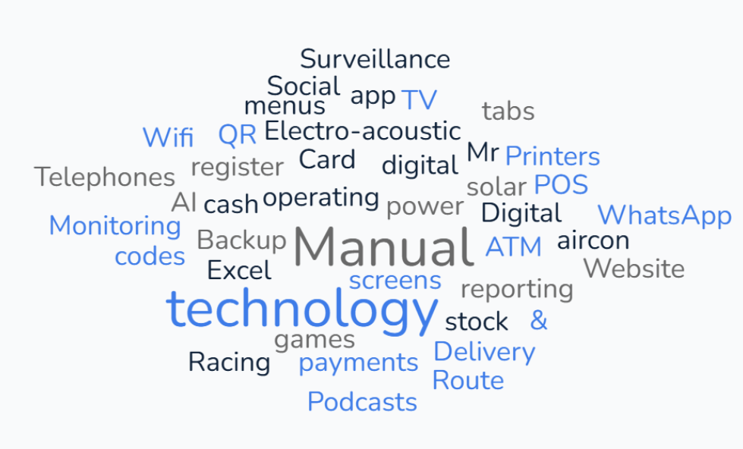
Digital technologies applications and infrastructure requirements to enable the LPM sites and Events niche area for development, growth and sustainability
Figure 3.9: Word cloud on the use of technology within LPM sites
Word cloud on the use of technology within the events sector

Slide 38
Support or training received on adopting digital technologies
Province | Interview ID(s) | Formal Training / Organisational Support | Informal / Partial Support | No Support Received
Eastern Cape | EOInterviews_EC_SMME1 | Local organisations & government initiatives providing training/resources for rural SMEs (Mount Ayliff). | – | –
Gauteng | EOInterviews_GP_SMME1–2, 3, 6, EOInterviews_WP_SMME1 | TUT (1–2); NYDA (3) – support with compliance, BizPortal, budgeting, online systems; Statesman Media (6); Paid international training (WP1, Glue Up, David Zimmerman). | In-house/self-taught (4, 10); YouTube (9) | 5, 7, 8, 11
KwaZulu-Natal | EOInterviews_KZ_SMME2, 4, 6, 9 | SEDA & SETA training/certificates; HACCP workshops; support visits from SEDA/SETA. | Online ticketing system (2); Online learning (4); Self-taught (7) | 1, 3, 5, 8, 10, 11
Limpopo | EOInterviews_LP_SMME2 | Johannesburg Business School – support on digital accessibility and multi-platform access. | – | –
Mpumalanga | EOInterviews_MP_SMME1–2 | – | – | 1, 2
North West | EOInterviews_NW_SMME1–2 | – | Self-taught online (1)

Slide 39
Which practical strategies and enablers can support the successful adoption of digital technology for the sustainability of niche tourism SMMEs
Embrace hybrid infrastructure enablers
Capacity-Building Programmes
Innovative Toolkits
Collaborative Ecosystems
Policy and Metrics-Driven Sustainability
Resilience to Infrastructure Constraints
Robust Security Frameworks
User-Centric Design
Financially Viable Models and Compliance Integration
Revenue Enhancement Strategies
Notes:
solar-powered edge computing hubs can provide affordable connectivity,
In urban hubs like Gauteng (76% 5G coverage), SMMEs can leverage existing 4G/5G infrastructure for metaverse previews of township / rural tours
drone swarms for biodiversity monitoring
Investment in digital marketing training, social media strategies and website optimisation can significantly enhance their market reach and business sustainability.
Use of digital twin to drive traffic
innovative toolkits such as open-source blockchain platforms for transparent, carbon-tracked supply chains in the Northern Cape’s desert eco-niches can attract ESG investors.
Use of DHL go green dashboard that provide real-time tracking of emissions across shipments
Public-private platforms, like a trusted and effective local booking hub, customised for a South African setting,
South Africa is still one of the few African countries where Starlink isn't officially licensed. Service providers such as HughesNet, which is a long-standing satellite provider with different data plans and Viasat, which offers satellite internet with a wide coverage area and varying data plans, sometimes providing higher data capacity, are some of the options for niche SMMEs in rural areas.

Slide 40
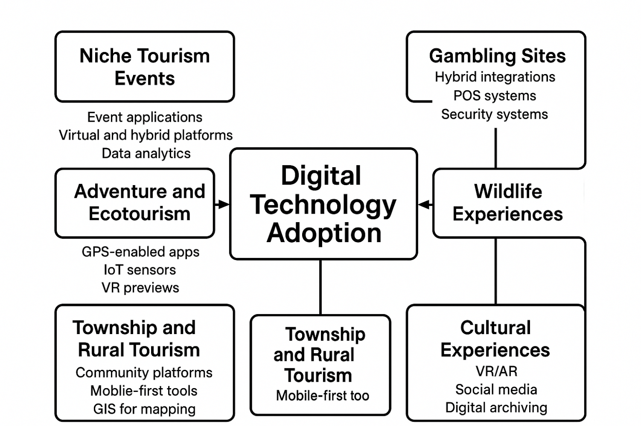
Sector-Specific Focus Areas for Digital Adoption
Notes:
Niche Tourism Events: Examining the adoption of digital tools in the planning, managing and implementing of events. The integration of digital tools, including online registration systems, event applications, virtual and hybrid platforms (conferencing), and data analytics, has streamlined operations and enhanced participant engagement. Event professionals increasingly rely on technologies like artificial intelligence, augmented reality, and social media analytics to personalise experiences, improve communication, and measure successTraining of various technological adoption processes should be encouraged in all sectors of events to increase efficiency and accessibility, as well as to position the industry for greater innovation and resilience in a rapidly evolving global environment.
Gambling Sites: Focus on hybrid digital-physical integrations in LPM sites for easier reporting, security and control purposes. A phased digital technology adoption process is recommended based on the various levels of digital adoption by LPMs. Greater discussions are to be held between LPM operators and owners due to the LPM operators running marketing and targeting customers on behalf of LPMs as well as the RMS utilized for gambling reporting. On the operational side, LPMs should be encouraged to be open for all forms of digital tools such as POS systems, digital inventory control systems and security systems which will all contribute to operational effectiveness despite the initial financial investment. Due to the limited technology utilized by LPMs, a great focus will also need to be placed in enhancing LPM employees digital proficiency.
Adventure and Ecotourism: Evaluate tools like GPS-enabled apps (e.g., All Trails or local equivalents) for route planning and IoT sensors for safety monitoring activities like bungee jumping or hiking in the Drakensberg. Highlight VR previews for eco-adventures to promote sustainability, as seen in circular economy models. Study adoption gaps in remote areas, where geospatial technologies could optimise site selection and reduce environmental impact
Wildlife Experiences: Probe digital enhancements in private parks (e.g., Kruger or Addo Elephant) such as wildlife tracking apps, drone footage for virtual safaris and AI for anti-poaching. Recommend assessing platforms like the private sectors’ and SANParks' online booking systems for accessibility, noting innovations in customer interfaces to boost revenue. Include community-led digital storytelling via apps to empower local guides.
Township and Rural Tourism: Investigate community-based platforms (e.g., Airbnb Experiences or local apps such as Township Tours) for promoting authentic stays and crafts. Focus on mobile-first tools for rural vendors, including GIS for mapping hidden gems and online marketplaces to overcome market access challenges. Explore how digital tech fosters sustainability in Soweto townships or Eastern Cape villages, where low connectivity hinders adoption.
Cultural Experiences: Analyse VR/AR for immersive heritage tours (e.g., Robben Island or Zulu cultural sites) and social media for user-generated content. Study digital archiving of traditions via apps, which may preserve intangible heritage while attracting millennials. Address inclusivity, ensuring tools like multilingual chatbots cater to diverse visitors.

Slide 41
Digital landscape & network infrastructure framework
Coverage(fibre, 4G/5G,satellite) reliability, affordability, public access points
Presence, bookings, payments, operations, data hygiene
Tap-to-pay, mobile wallets, cross-boarder, forex costs, reconciliation
Infrastructure Mapping
Access, Inclusion, Skills
SMME Digital Readiness
Tourism CX & Distribution
Payments and Fintech
Data & Analytics
Devices, digital literacy, multilingual and accessible content
OTA listings, maps, reviews, local discovery, content quality
Dashboards, demand signals, seasonality privacy-by-design (POPIA)
Notes:
What can be done to address the key priorities of the GNU includes driving inclusive growth and job creation, reducing poverty, tackling the high cost of living, and building a capable, ethical state.

Slide 42
Application programming interface (APIs), open data, standards for listings, bookings and events
Subsidies, spectrum, WISP enablement, procurement, tax incentives
Fibre backbones, WISP, last-mile, power resilience, shade facilities
Platforms & interoperability
Security & Trust
Policy & Incentives
Training & Support
Infrastructure Projects
KPIs
Multi-factor Authentication (MFA), phishing, device hardening, backups, and incident response.
Curricula, train-the-trainer, helpdesks, certification, cohorts
Coverage %, price/Mbps, SMME adaptation, conversion, uptime, NPS
Equity lens, climate resilience, vendor lock-in mitigation
Risk & Resilience
24- Month Roadmap
0-3m baseline, 3-6m enablement, 6-12m scale 12-24m advanced
Notes:
he key priorities of the GNU include driving inclusive growth and job creation, reducing poverty, tackling the high cost of living, and building a capable, ethical state.

Slide 43
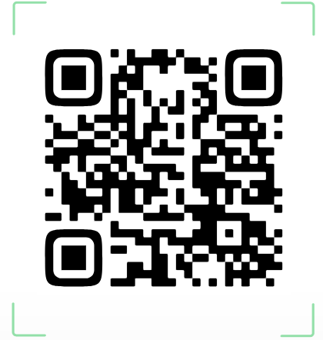
“Pioneering a vibrant, sustainable tourism future through innovation, inclusion, and impact!"

